Slide 1
Topics to be covered :
UNIT-4. HEAPS and TREES
1. TREES : Basic tree concepts, Binary trees, Binary search tree (BST) concept, BST operations.
2. HEAPS : Basic concepts, Heap implementation, Heap applications.
Upon completion you will be able to
Explain Basic Tree concepts.
Implement Binary search tree (BST)
Explain Basic concepts of Heap
Implement the Heap and know about its applications

Slide 2
1. Introduction
2. What is TREE Data Structure?
3. Why TREE data structure needed?
4. Important Terms related TREE Data structure
5. Types of TREES
6. Representation of TREES
7. Basic on operations on Binary trees and Binary Search
Trees
8. Binary Tree implemetation using Linked List
9. Binary Search Tree implemetation using Linked List

Slide 3
INTRODUCTION :
There are many basic data structures that can be used to solve application problems.
Array is a good static data structure that can be accessed randomly and is fairly easy to implement.One drawback of Array is size is fixed during the execution.
Linked Lists on the other hand is dynamic and is ideal for application that requires frequent operations such as add, delete, and update. One drawback of linked list is that data access is sequential.
Then there are other specialized data structures like, stacks and queues that allows us to solve many complicated problems using these restricted data structures.

Slide 4
2. What is TREE ?
We studied the linear data structures like an array, linked list, stack and queue in which all the elements are arranged in a sequential manner.
A tree is a non-linear Data structure with a hierarchy-based structure. i.e. the elements are not strored in a linear sequence, instead the elements are organized in a hierarchical structure with each element having parent-child relationship with other elements
More precisily Tree consists of nodes (where the data is stored) that are connected via links. The tree data structure stems from a single node called a root node and has subtrees connected to the root.

Slide 5
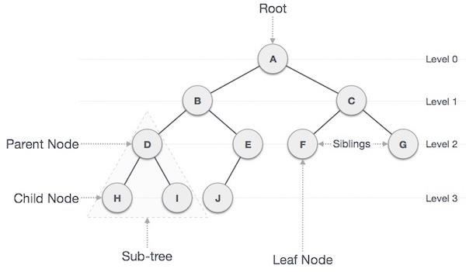
Formally, Tree data structures is defined as a Finite Set of One or More nodes such that
1. There is a Specially designated node called the root.
2. The remaining nodes are partitioned into n>=0 disjoint
sets T1, T2, ........Tn., where each of these sets is a tree. T1, T2, ........Tn., are called the subtrees of a root.

Slide 6
3. The Necessity for a Tree in Data Structures
Time complexity increases with increasing data size to perform operations like insertion and deletion on these linear data structures. But it is not acceptable for today's world of computation.
The non-linear structure of trees enhances the data storing, data accessing, and manipulation processes by employing advanced control methods of traversal through it.

Slide 7
4. Important Terms related Tree Data structure

Slide 8
Important Terms related Tree Data structure
Following are the important terms with respect to tree.
Path − Path refers to the sequence of nodes along the edges of a tree.
Root − The node at the top of the tree is called root. There is only one root per tree and one path from the root node to any node.
Parent − Any node except the root node has one edge upward to a node called parent.
Child − The node below a given node connected by its edge downward is called its child node.
Leaf − The node which does not have any child node is called the leaf node.

Slide 9
Subtree − Subtree represents the descendants of a node.
Visiting − Visiting refers to checking the value of a node when control is on the node.
Traversing − Traversing means passing through nodes in a specific order.
Levels − Level of a node represents the generation of a node. If the root node is at level 0, then its next child node is at level 1, its grandchild is at level 2, and so on.
Keys − Key represents a value of a node based on which a search operation is to be carried out for a node.
Siblings - Children of the same parent nodes are called Siblings

Slide 10
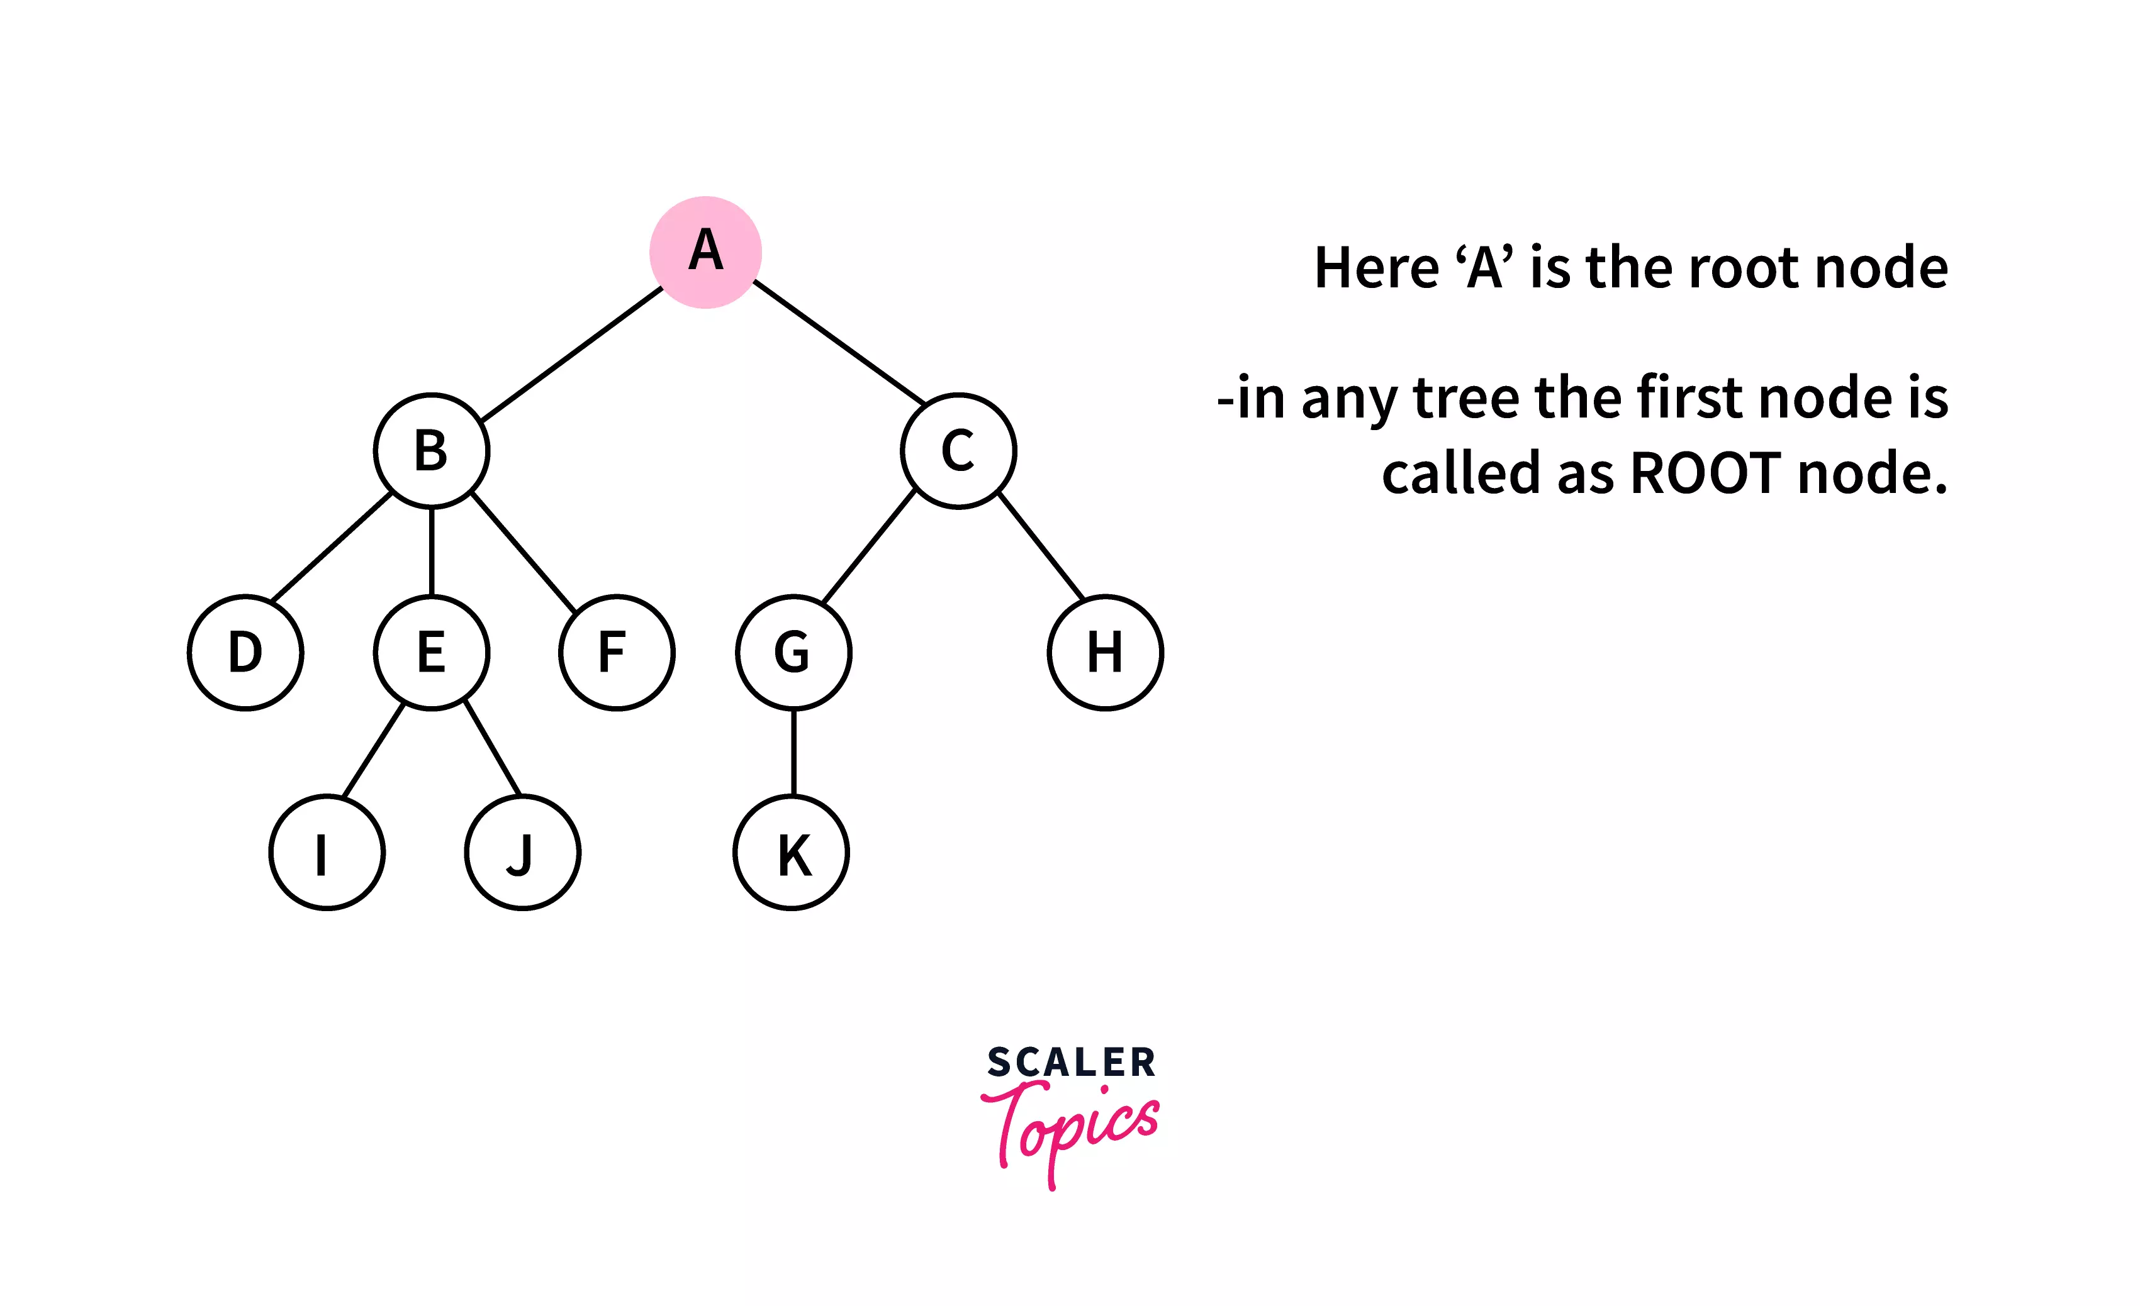
4.1. Root :
The first node of the binary tree is known as the root node of the binary tree. There cannot be any tree without a root node, as it is the tree's origin, and the root node has no parent element. We cannot have more than one root node in a tree.

Slide 11
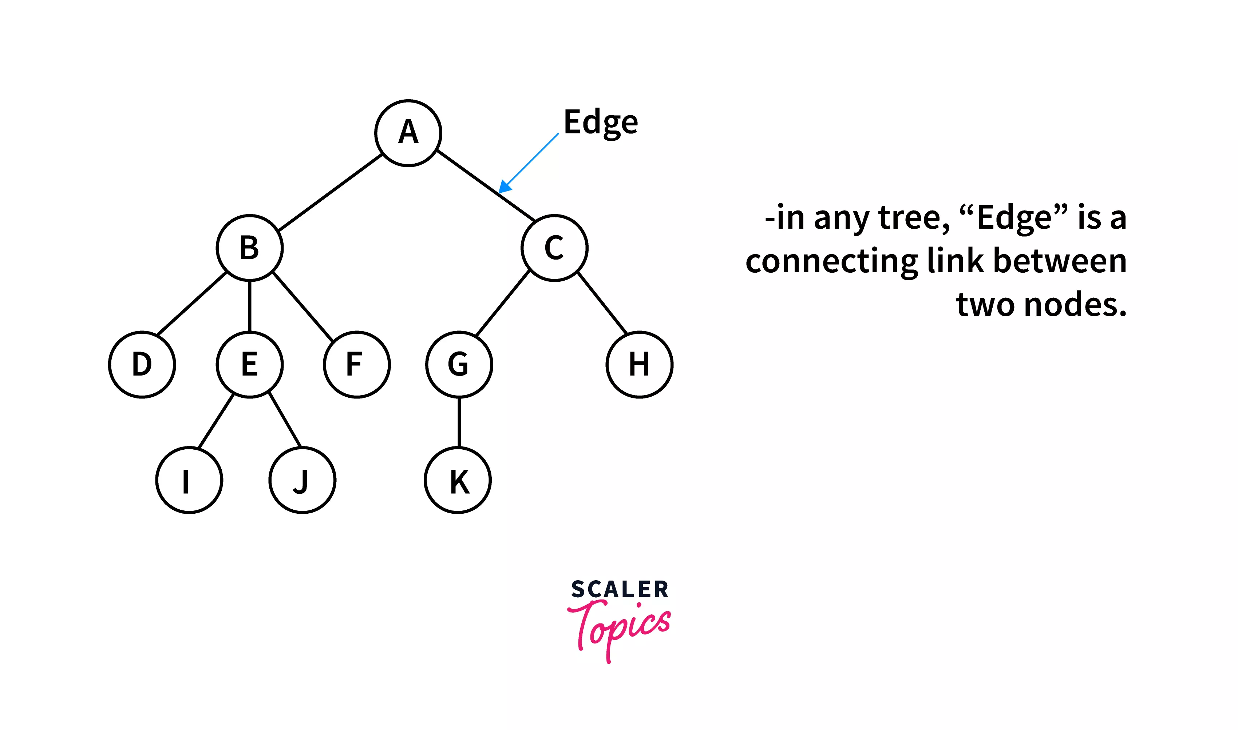
4.2. Edge :
The connecting link between the two nodes is known as the edges of the tree. It is also referred to as the branch of a tree.
If there are n nodes in a binary tree, there will be a total of n-1 edges.

Slide 12
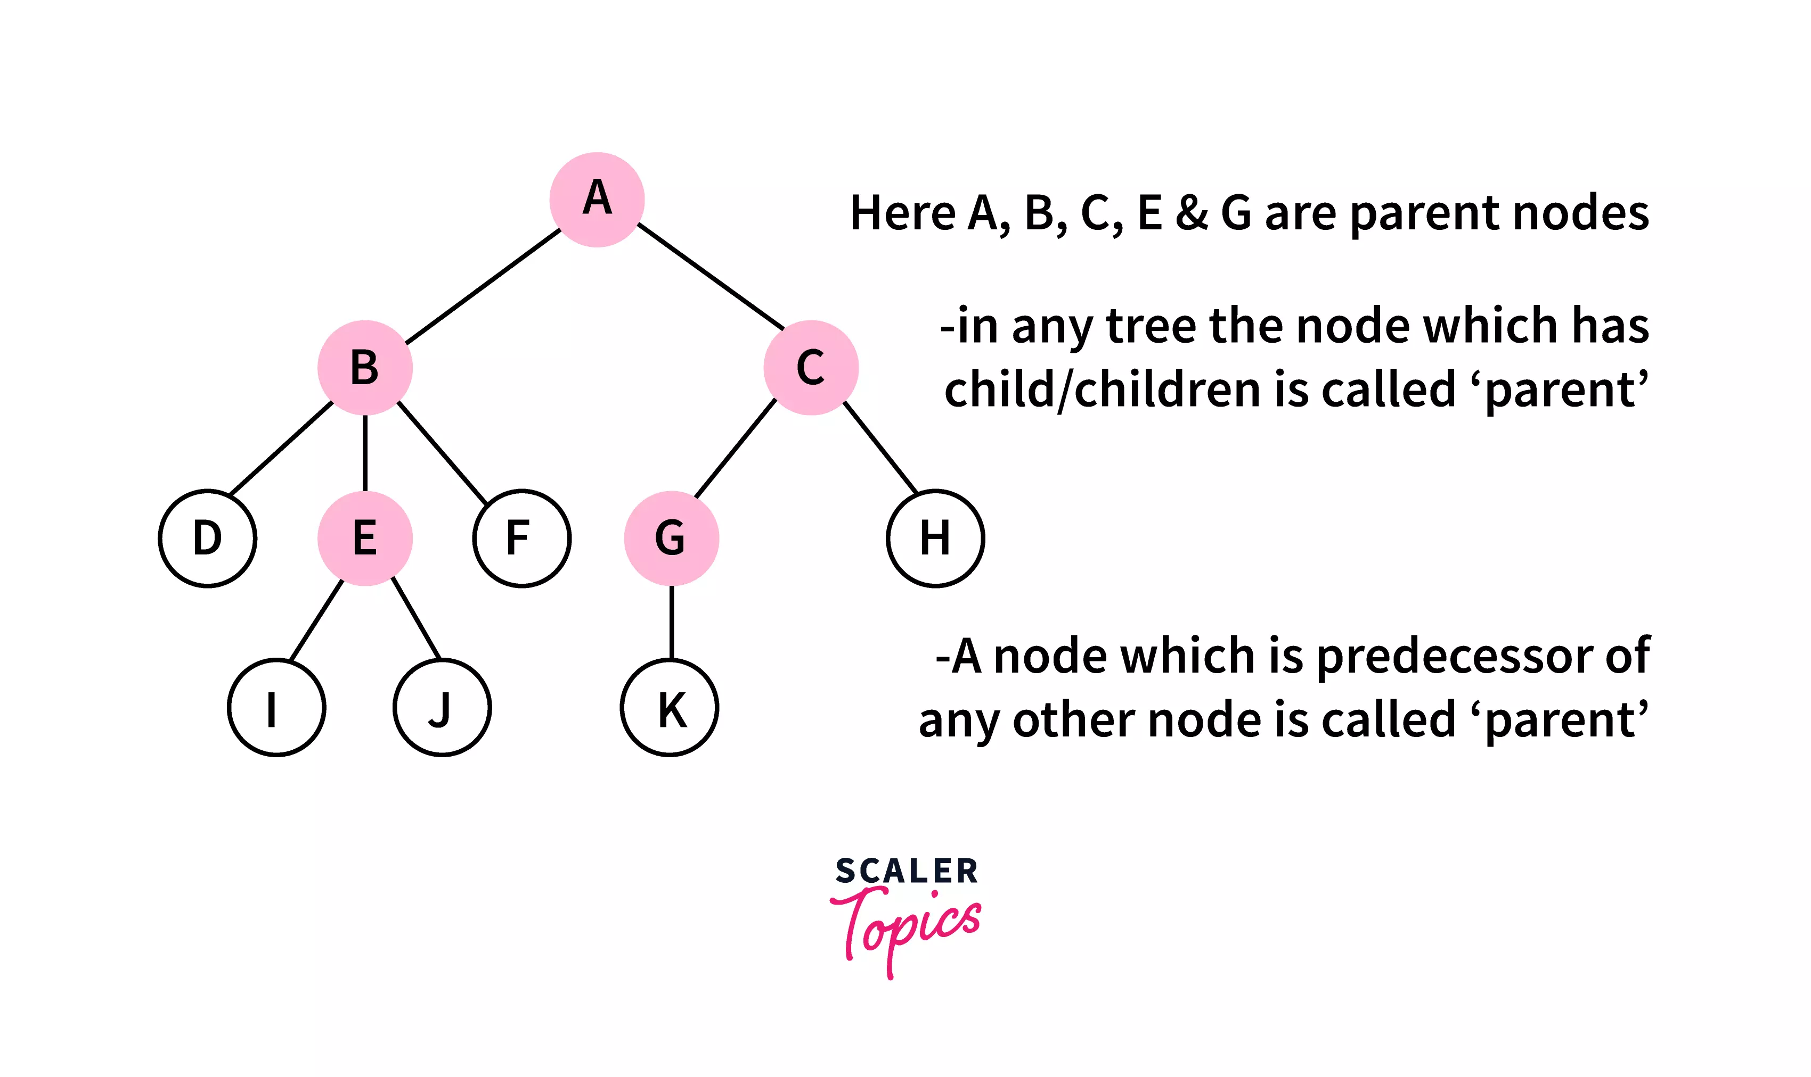
4.3. Parent : A node that has a connecting link to another node in the level below is known as a parent node.
In a more formal term, a node that is a predecessor of another node is called a parent node.

Slide 13
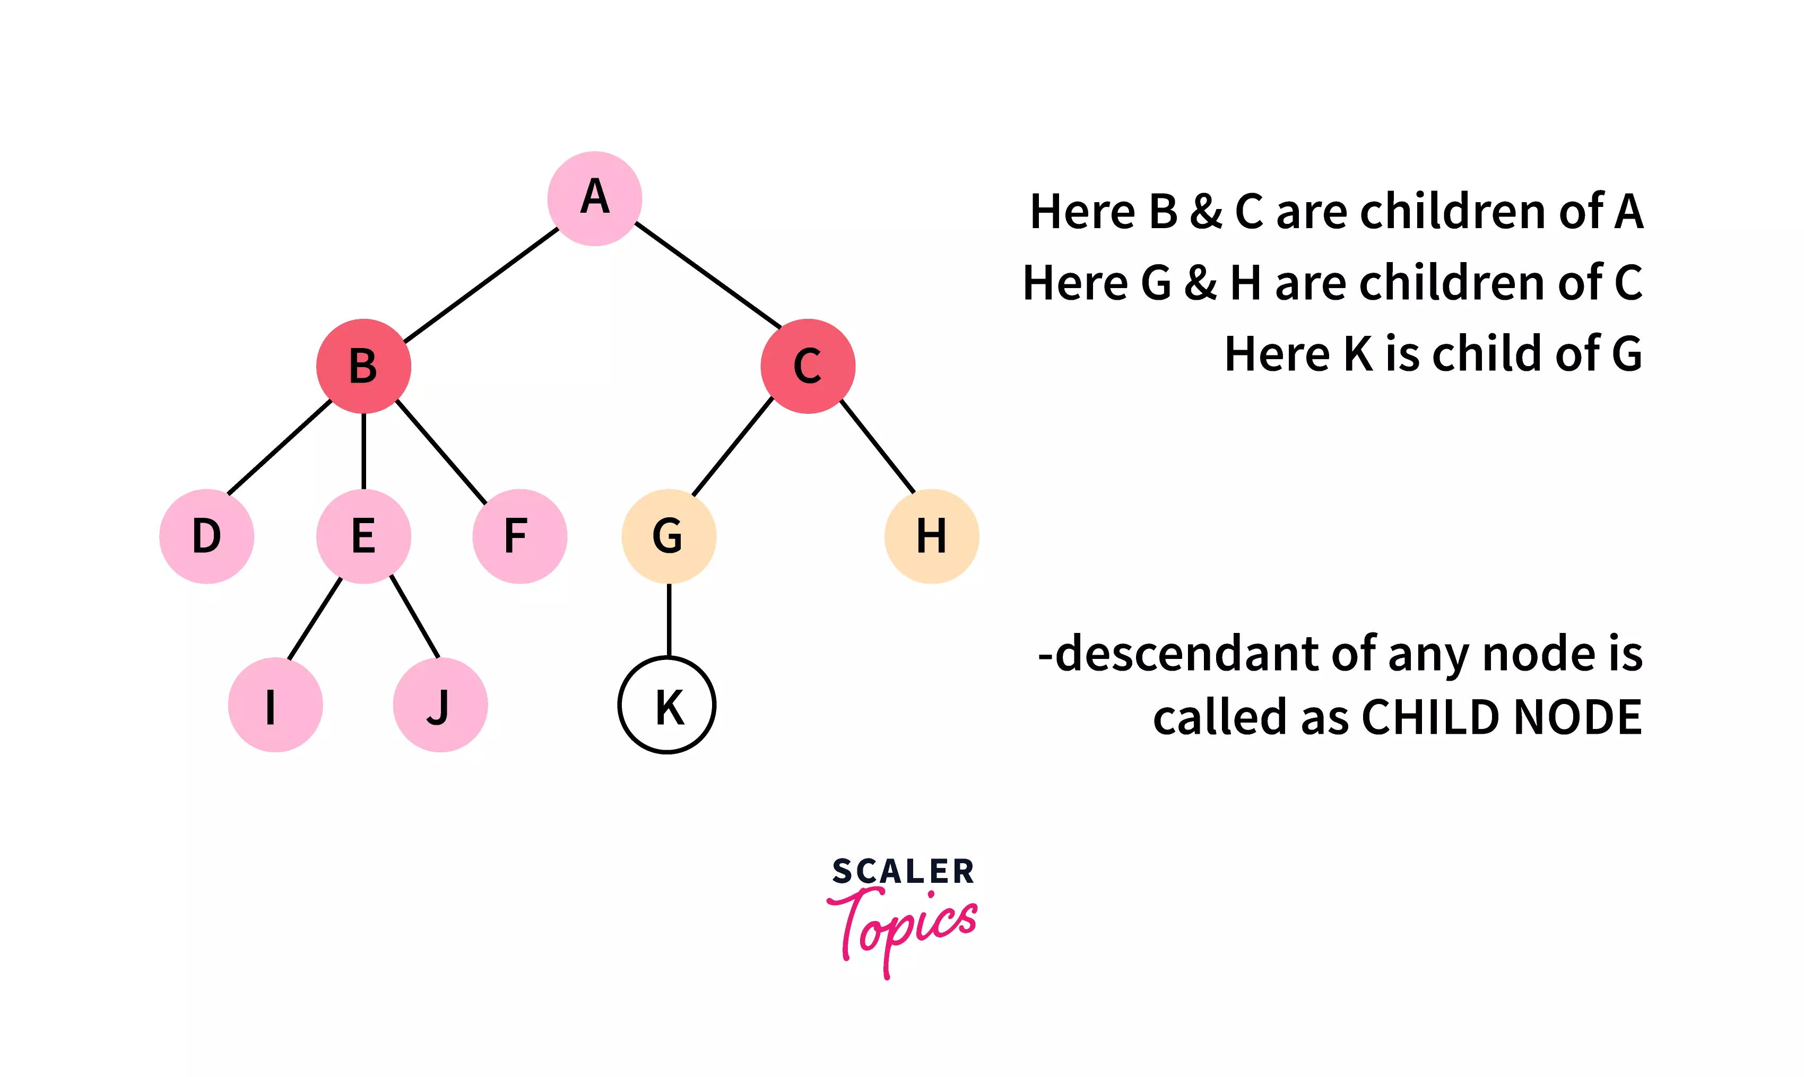
4.4. Child : Any node connected to a node one level above it is known as the child node. In formal terms, every node that is a descendant of any node is known as a child node.
Every node present in the tree can be considered as a child node except the root node

Slide 14
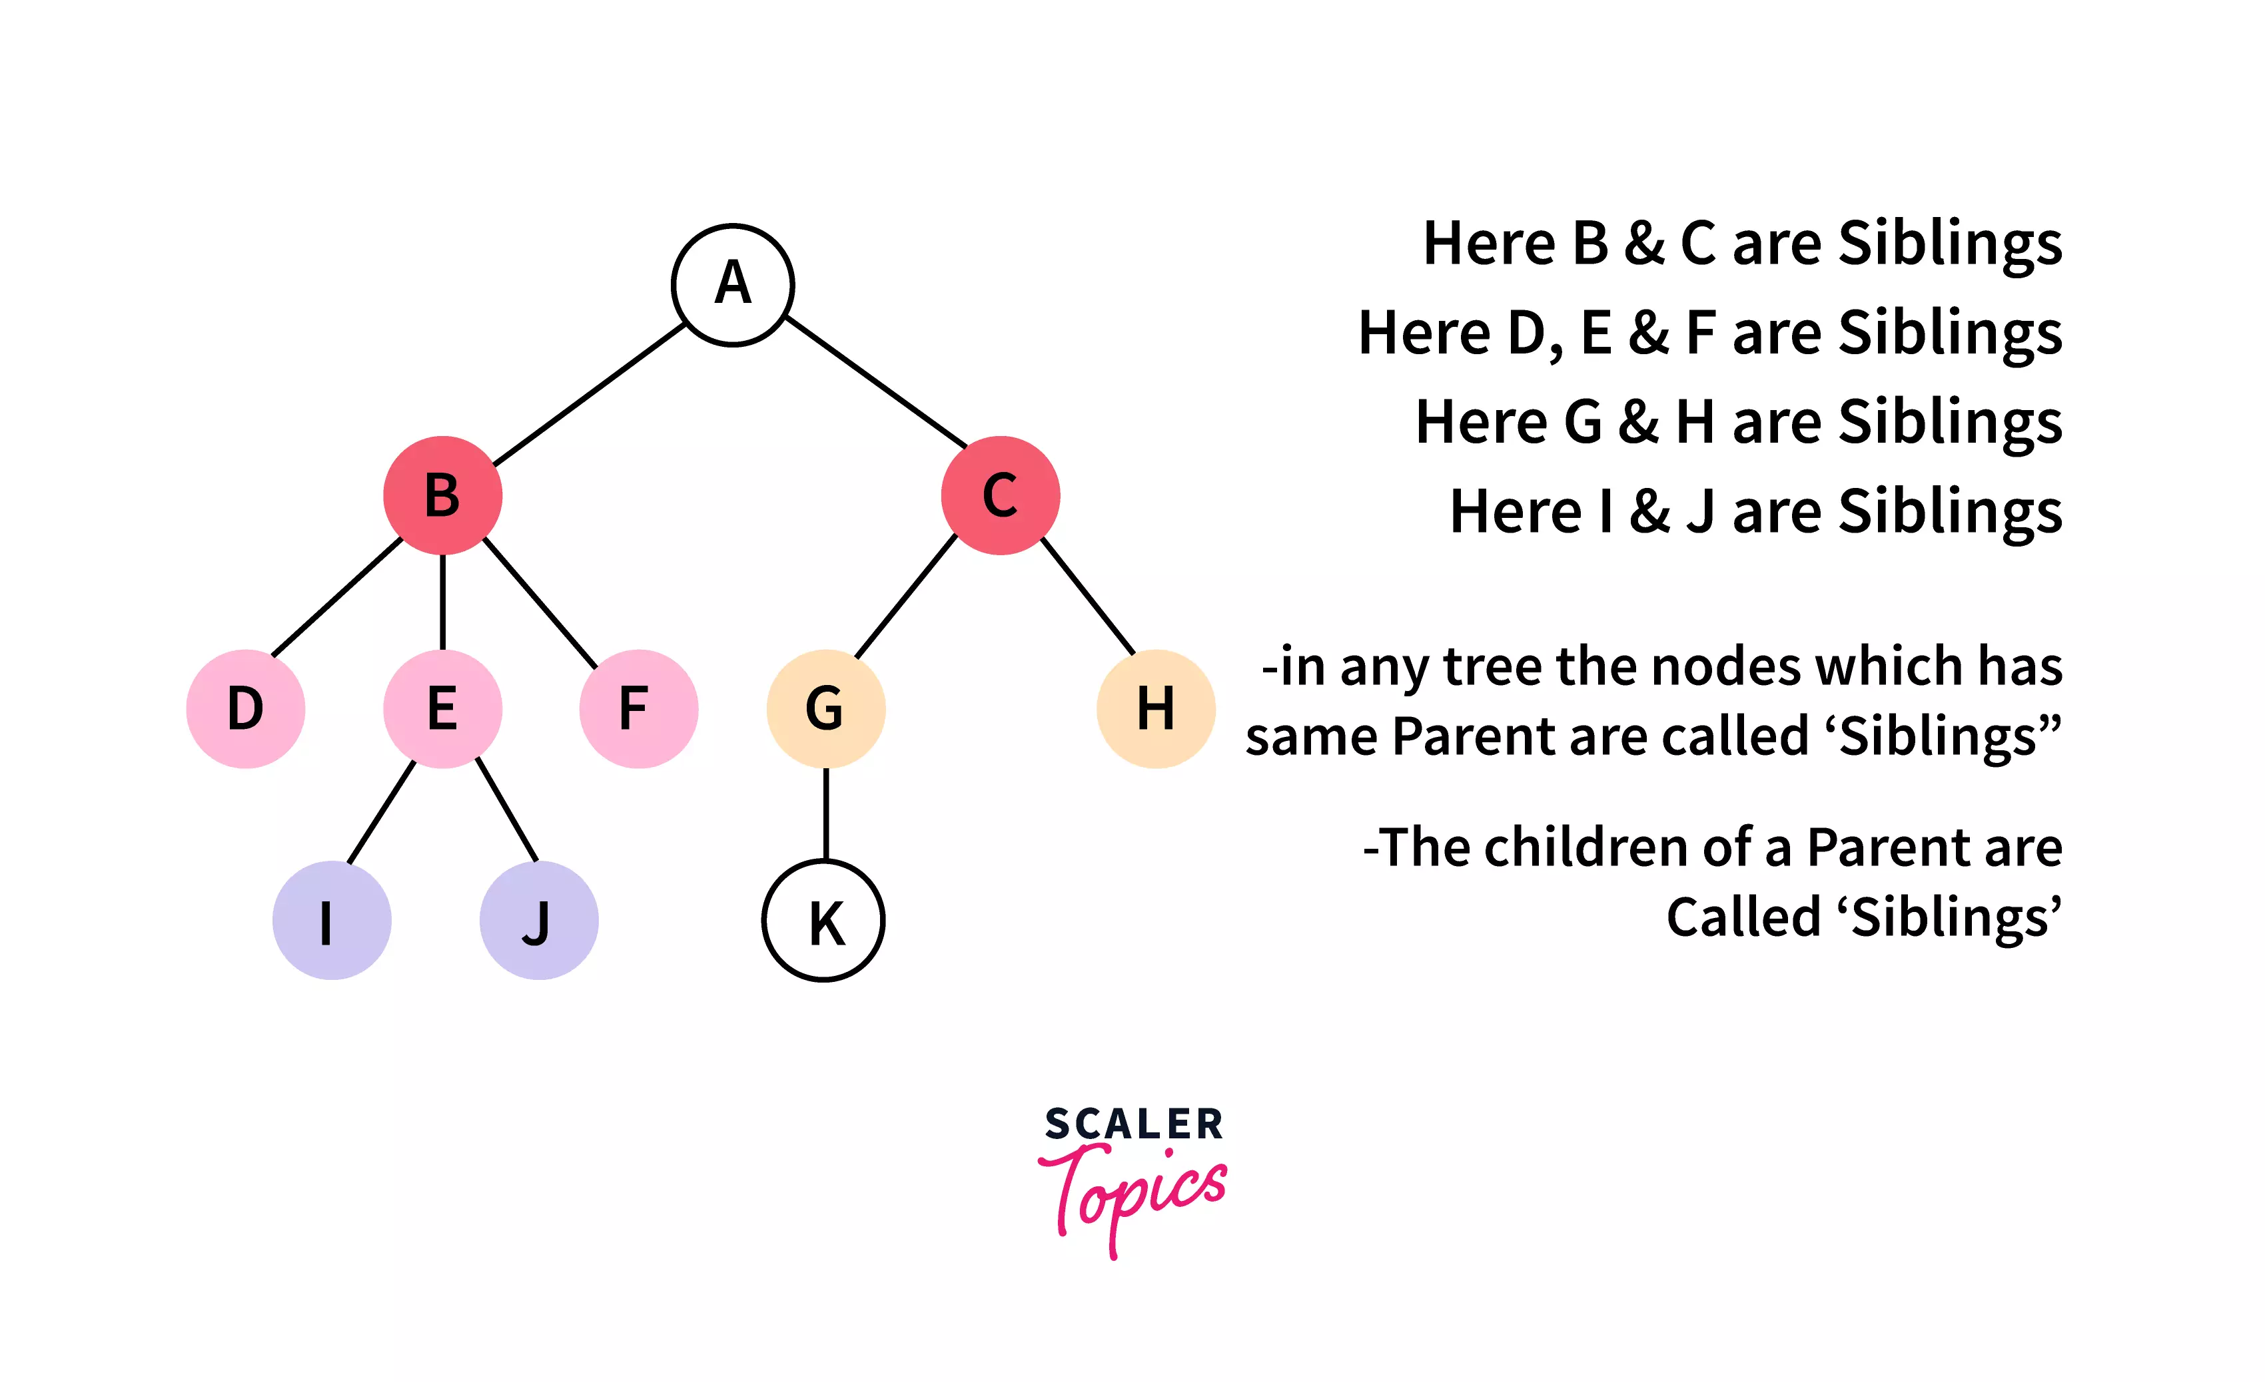
4.5. Siblings : The children node that shares the same parent node are referred to as siblings

Slide 15
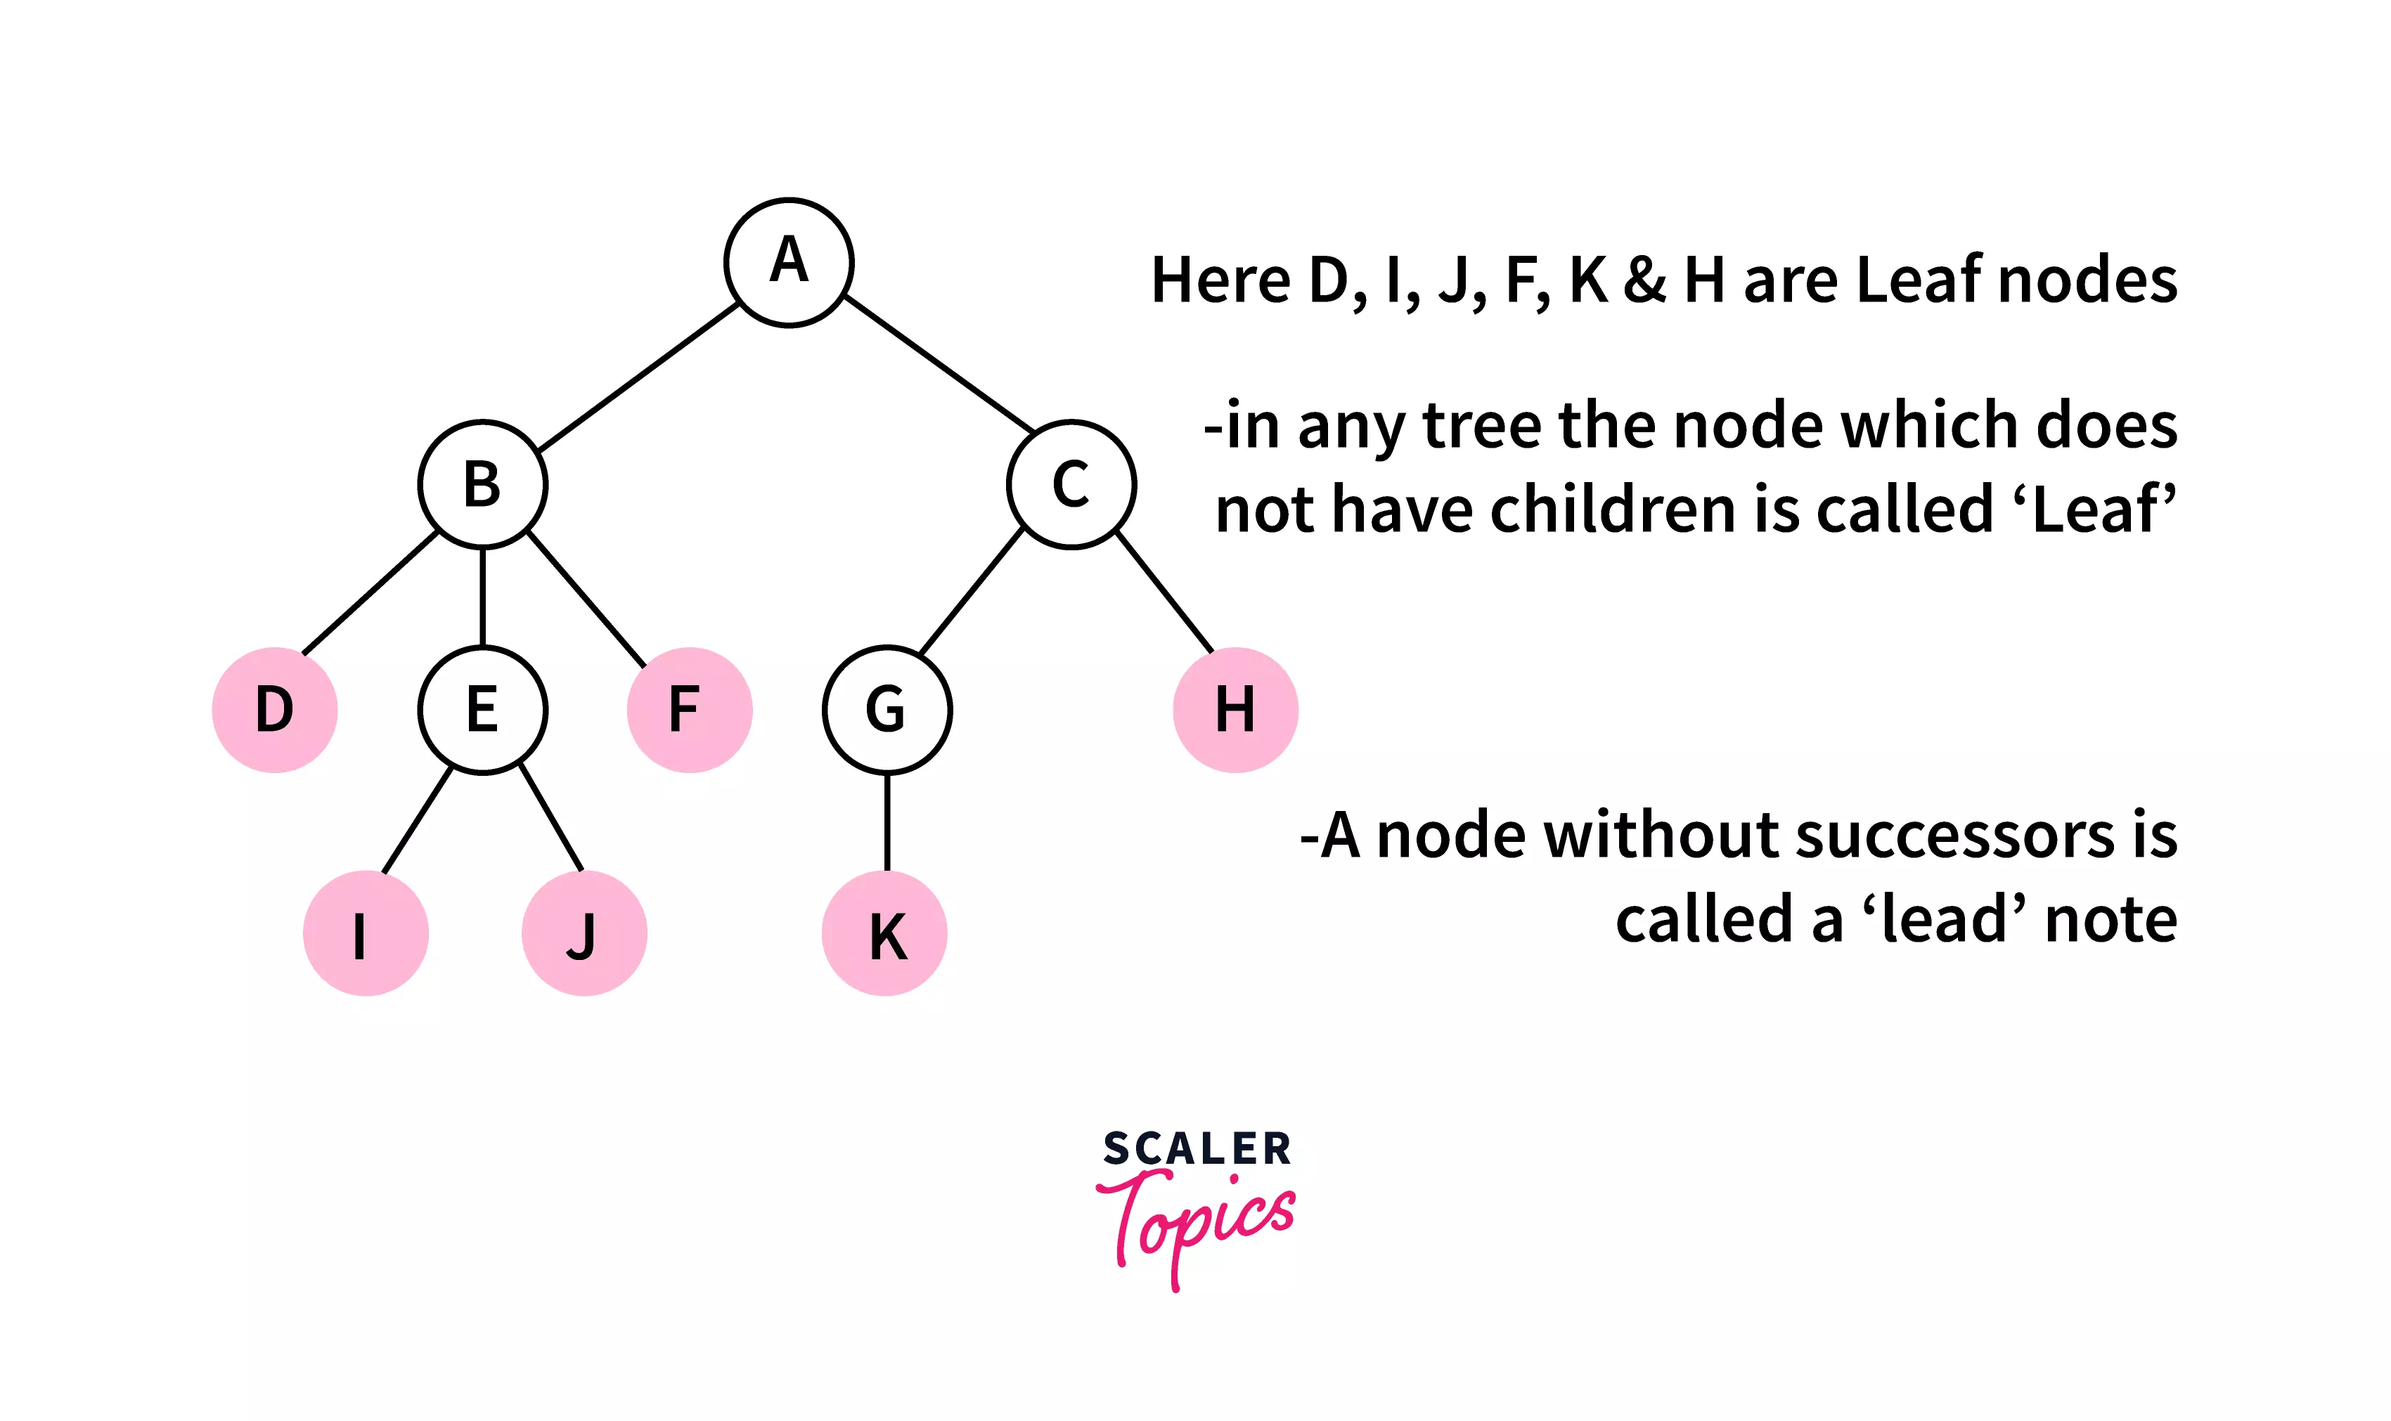
4.6. Leaf : A node with no child is known as a leaf node. It is the terminal node of the tree

Slide 16
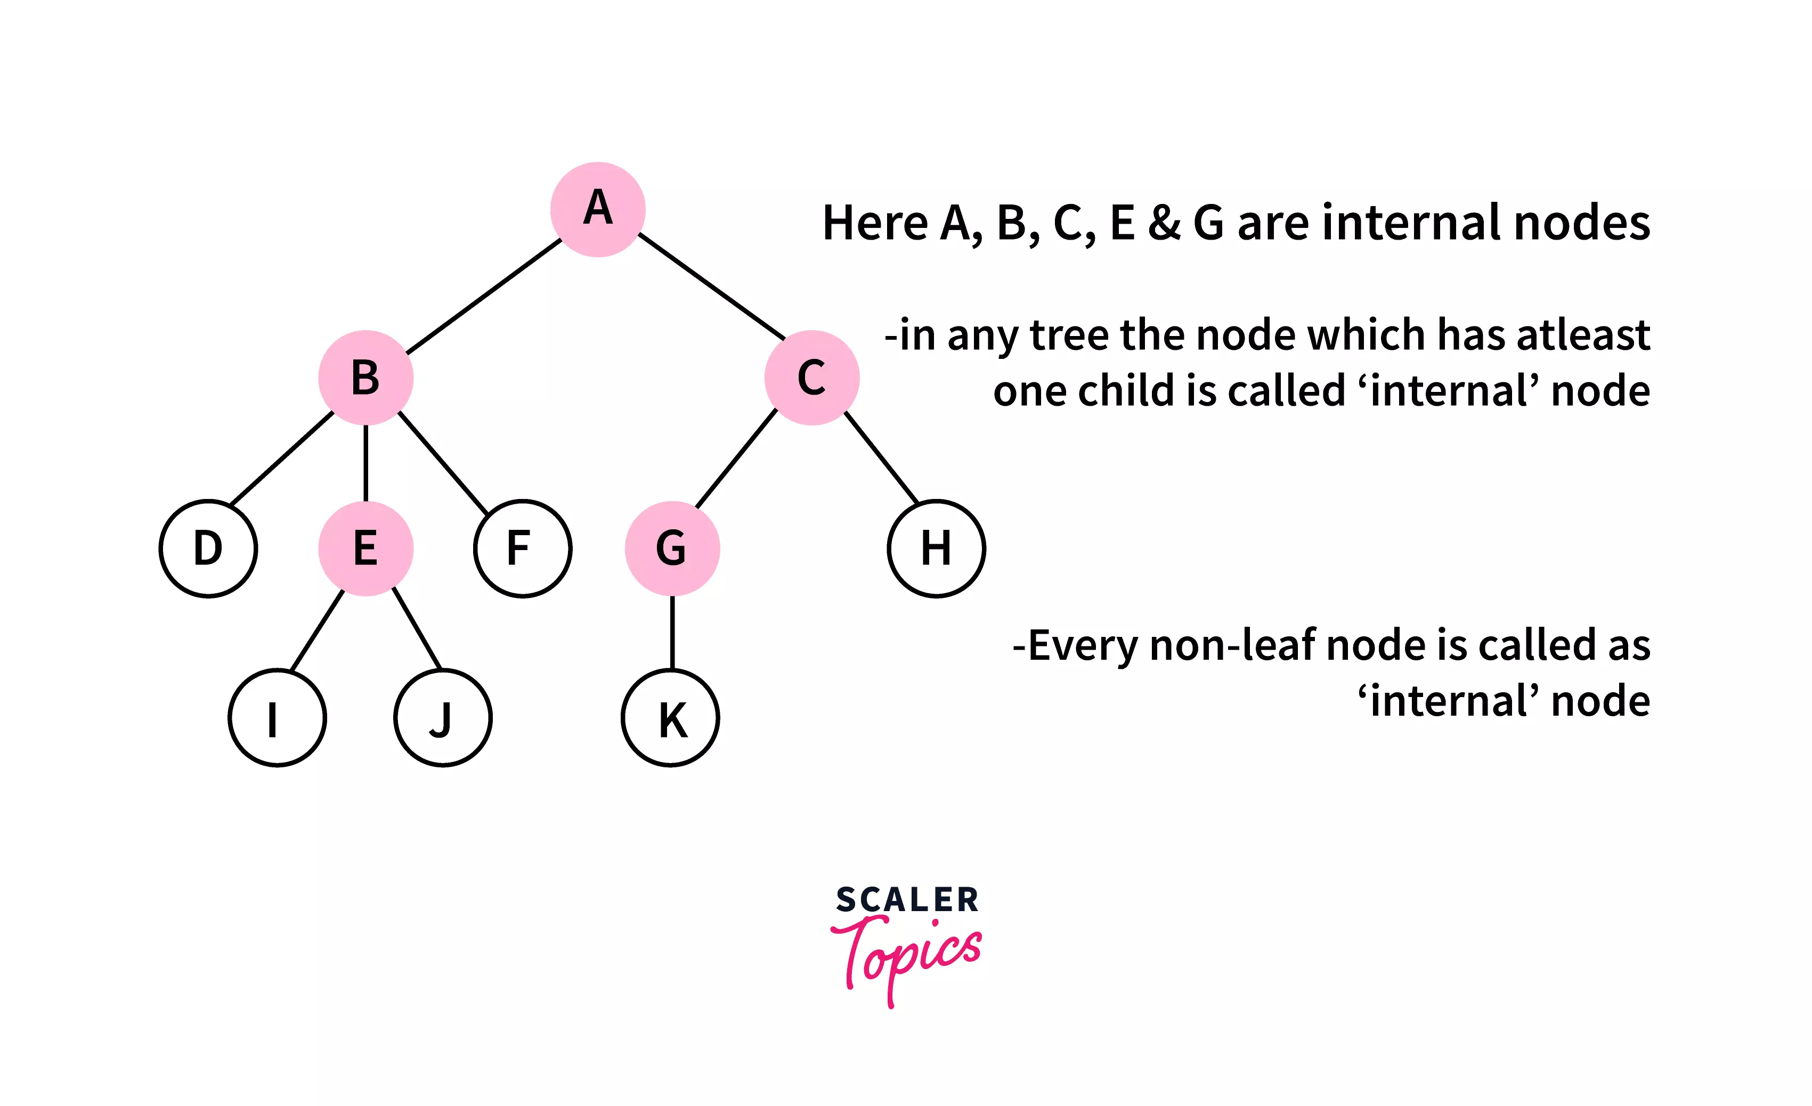
4.7. Internal Node :
The nodes with at least one child node are known as internal nodes. Every node (even the root node) is internal except the leaf nodes

Slide 17
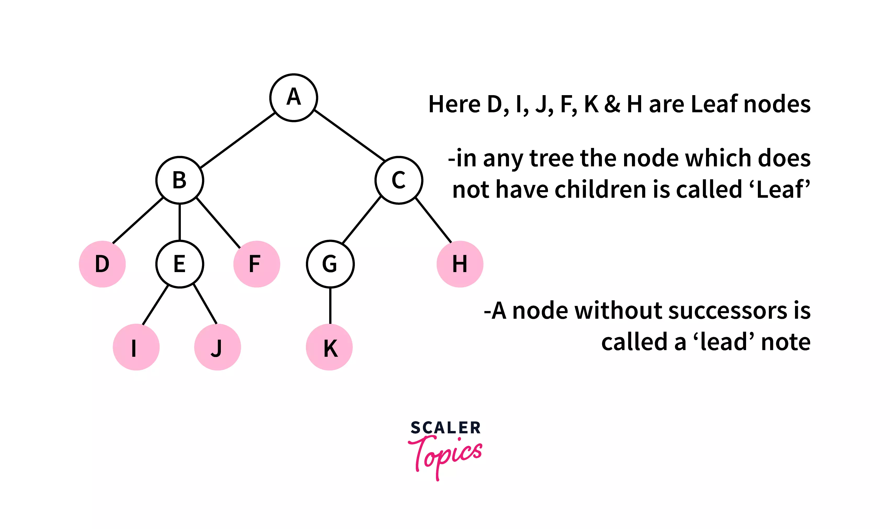
4.8. External Node : A node with no child node is considered an external node.

Slide 18
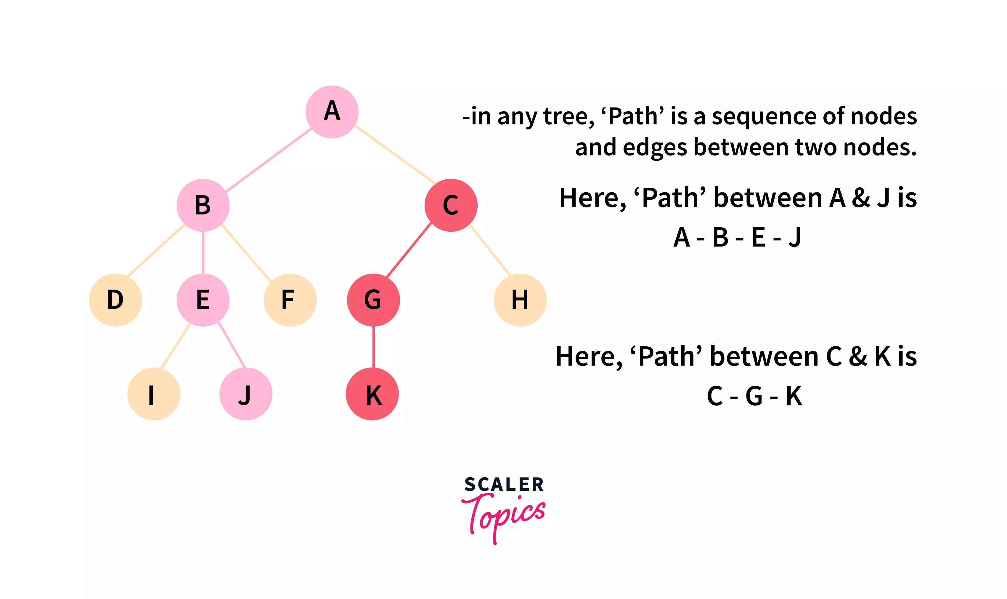
4.9. Path : A path between any two nodes of a tree is the sequence of connected nodes along with the edges between the two nodes. And the path length is the number of nodes present between two nodes.

Slide 19
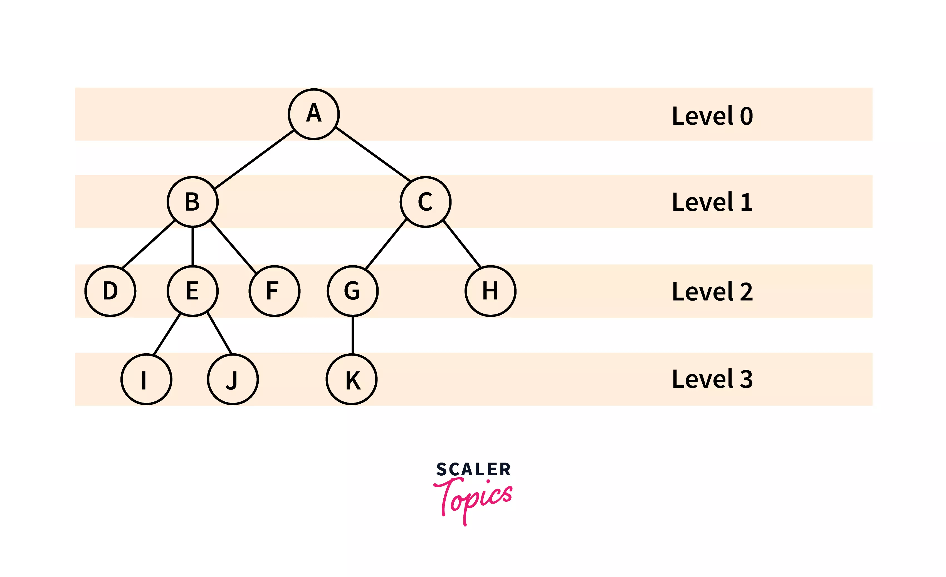
4.10. Level : The level in the tree represents the number of steps from the top/root.
The root node of the tree is said to be at level 0, and as we go downwards the level increases

Slide 20
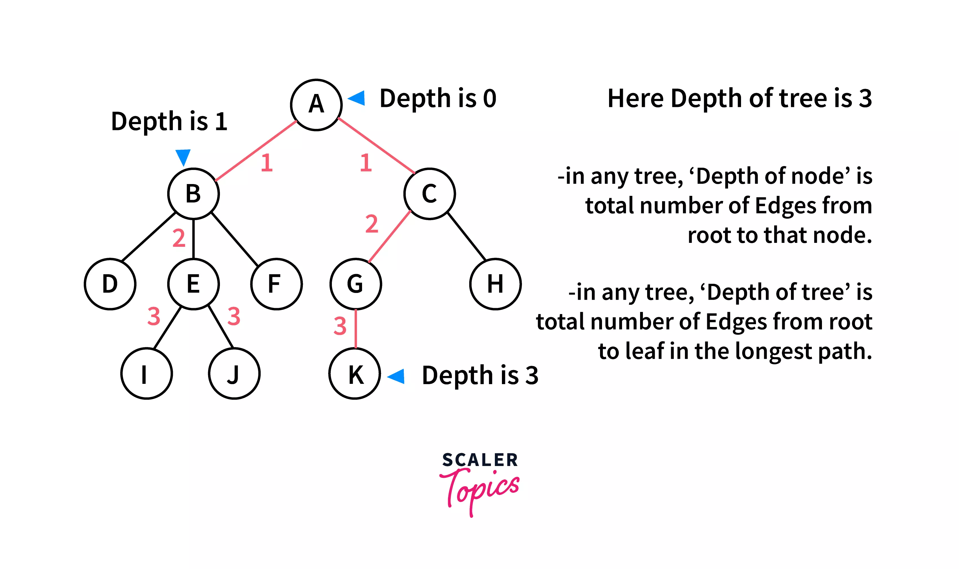
4.11. Depth : The depth of any node in the tree is the length of the path from the root node to that particular node,
i.e., The number of nodes between that particular node and the root node

Slide 21
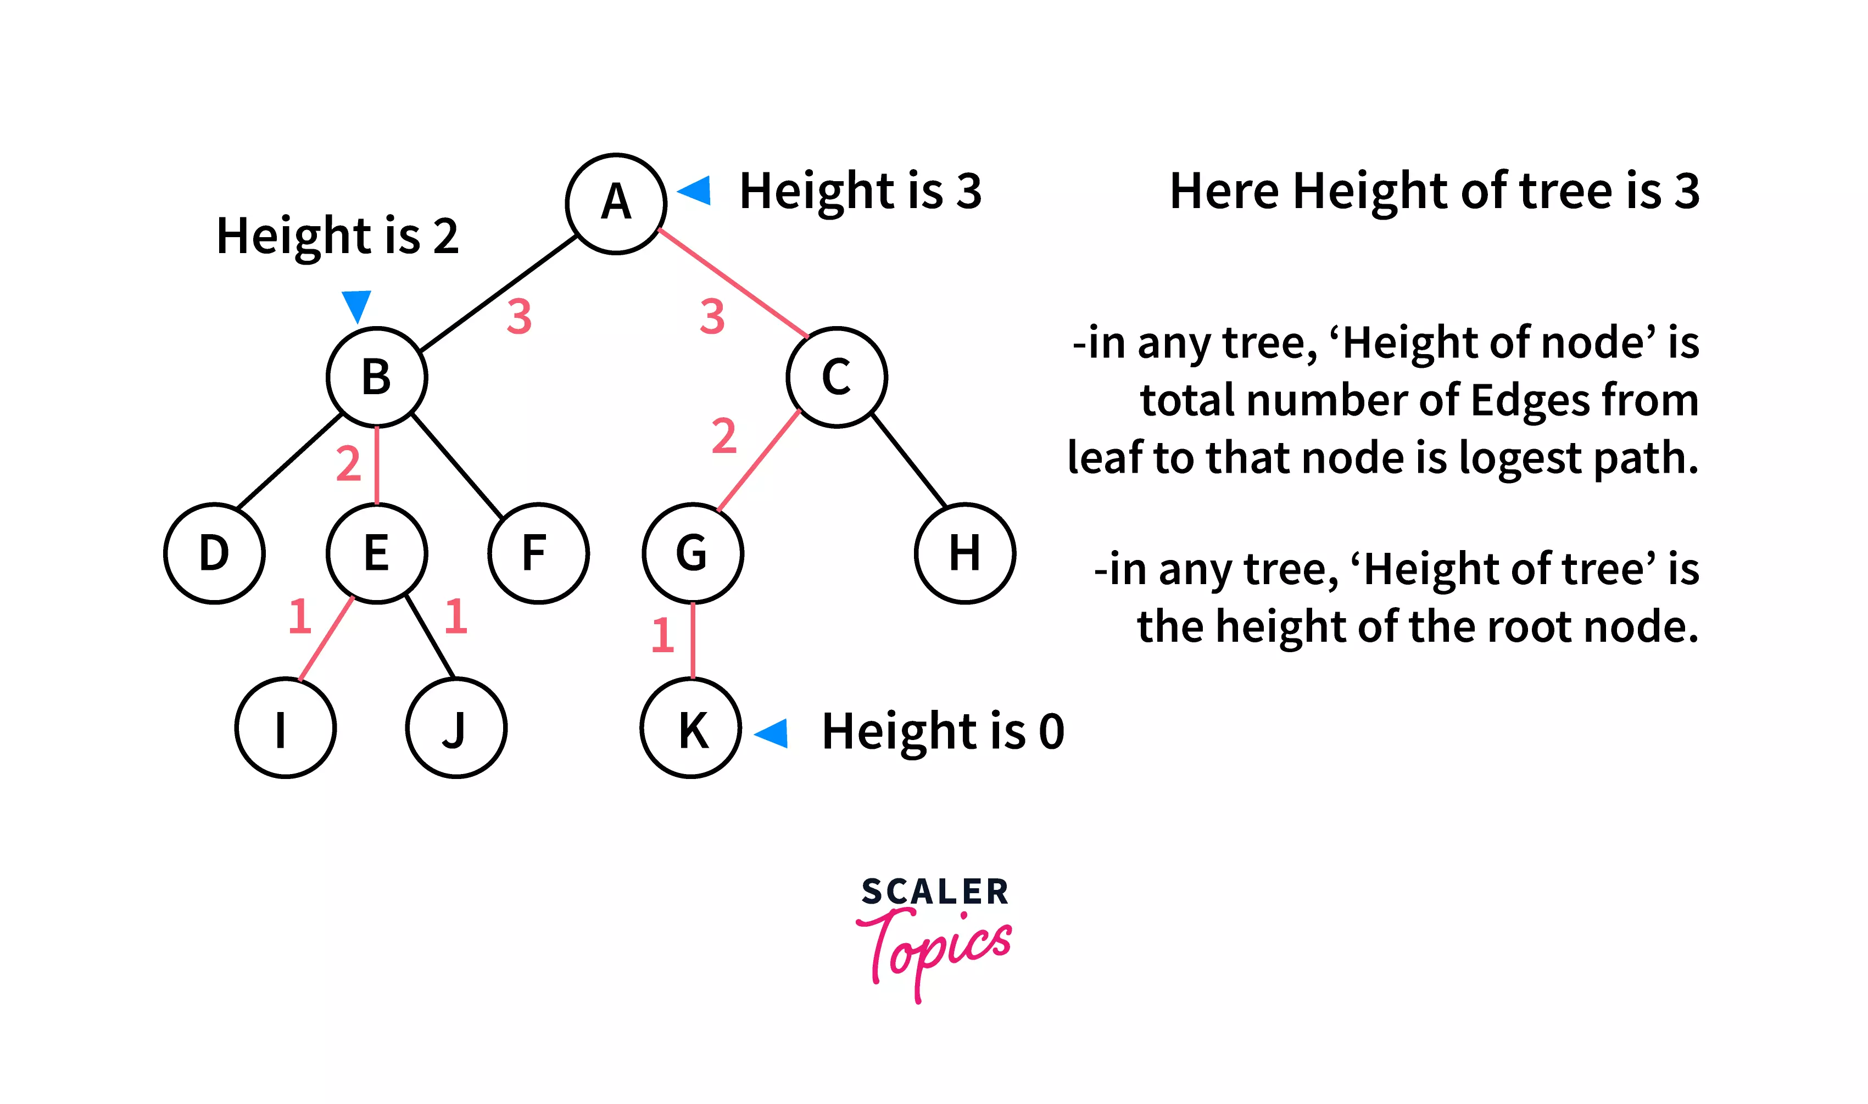
4.12. Height : The height of any node is given by the maximum number of edges from the leaf node to that particular node

Slide 22
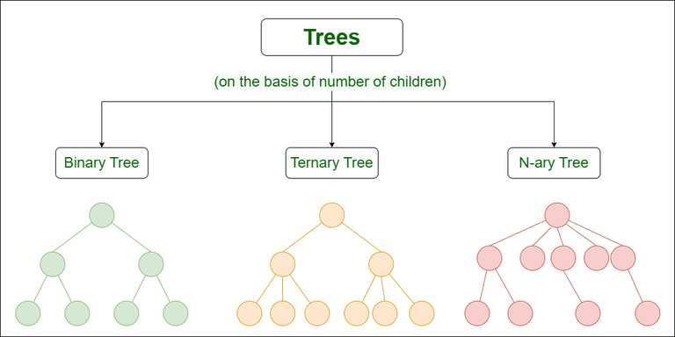
5. Types of Trees

Slide 23
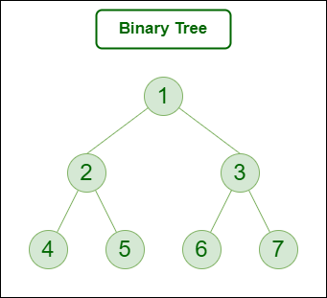
5.1. Binary Tree : A binary Tree is defined as a Tree data structure with at most 2 children.
Since each element in a binary tree can have only 2 children,
we typically name them as the left and right child of a Binary
tree.
Since each node of this tree has only 2 children, it can be said that this tree is a Binary Tree

Slide 24
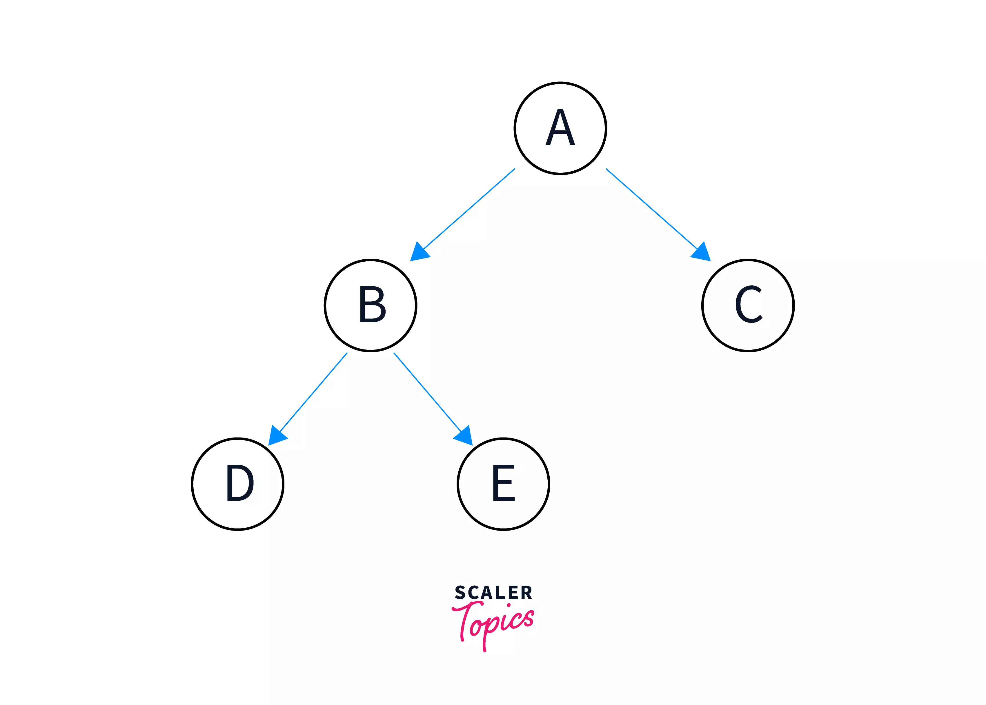
There are Four types of Binary Trees
5.1.1. Full Binary tree
5.1.2. Perfect Binary Tree
5.1.3. Complete Binary Tree
5.1.4. Binary Search Tree
5.1.1 Full Binary Tree : In a full binary tree, every node has either 0 or two children. It is also referred to as a strict binary tree.

Slide 25
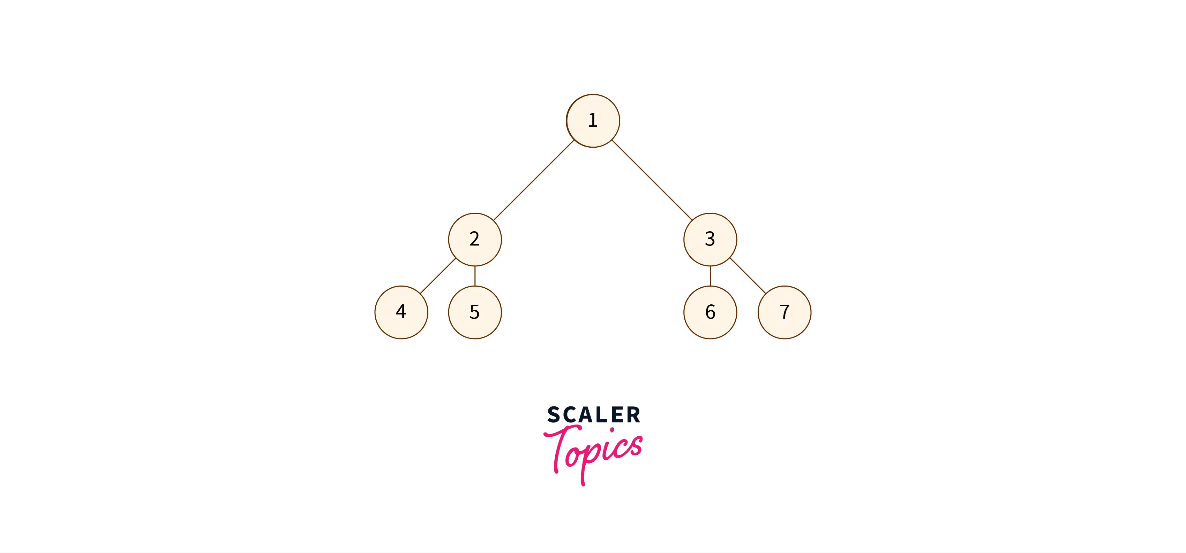
5.1.2. Perfect Binary Tree : As the name suggests, a perfect binary tree is one in which all the nodes(internal nodes) have two children and all the leaf nodes are at the same level.

Slide 26
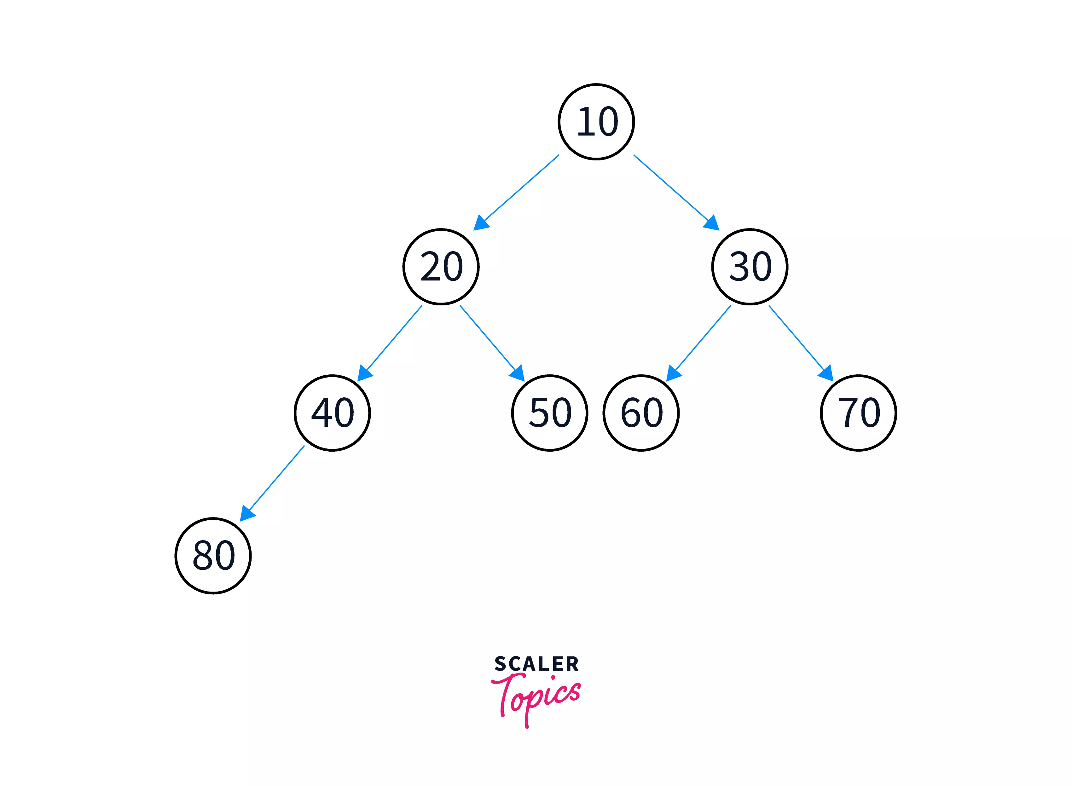
5.1.3. Complete Binary Tree : In a complete binary tree, all the levels except the last level (that contains the leaf nodes) should be full.

Slide 27
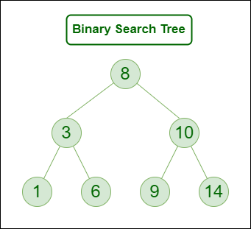
5.1.4. Binary Search Tree : A binary search Tree is a Special Type of Binary Tree and is a node-based binary tree data structure that has the following properties:
1. The left subtree of a node contains only nodes with keys lesser than the node’s key.
2. The right subtree of a node contains only nodes with keys greater than the node’s key.
3. The left and right subtree, each must also be a binary search tree.

Slide 28
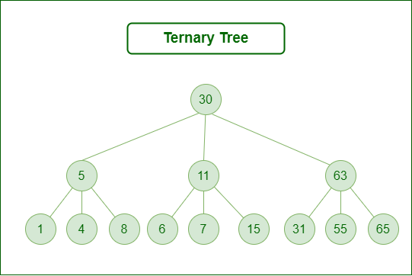
5.2. Ternary Tree : A Ternary Tree is a tree data structure in which each node has at most three child nodes, usually distinguished as “left”, “mid” and “right”.
Since each node of this tree has only 3 children, it can be said that this tree is a Ternary Tree

Slide 29
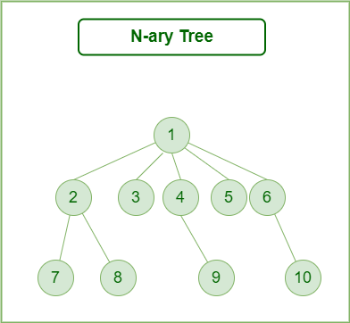
5.3. N-ary Tree (Generic Tree): A Generic trees are a collection of nodes where each node is a data structure that consists of records and a list of references to its children(duplicate references are not allowed). The Generic trees are the N-ary trees which have the following properties:
1. Many children at every node.
2. The number of nodes for each node
is not known in advance.

Slide 30
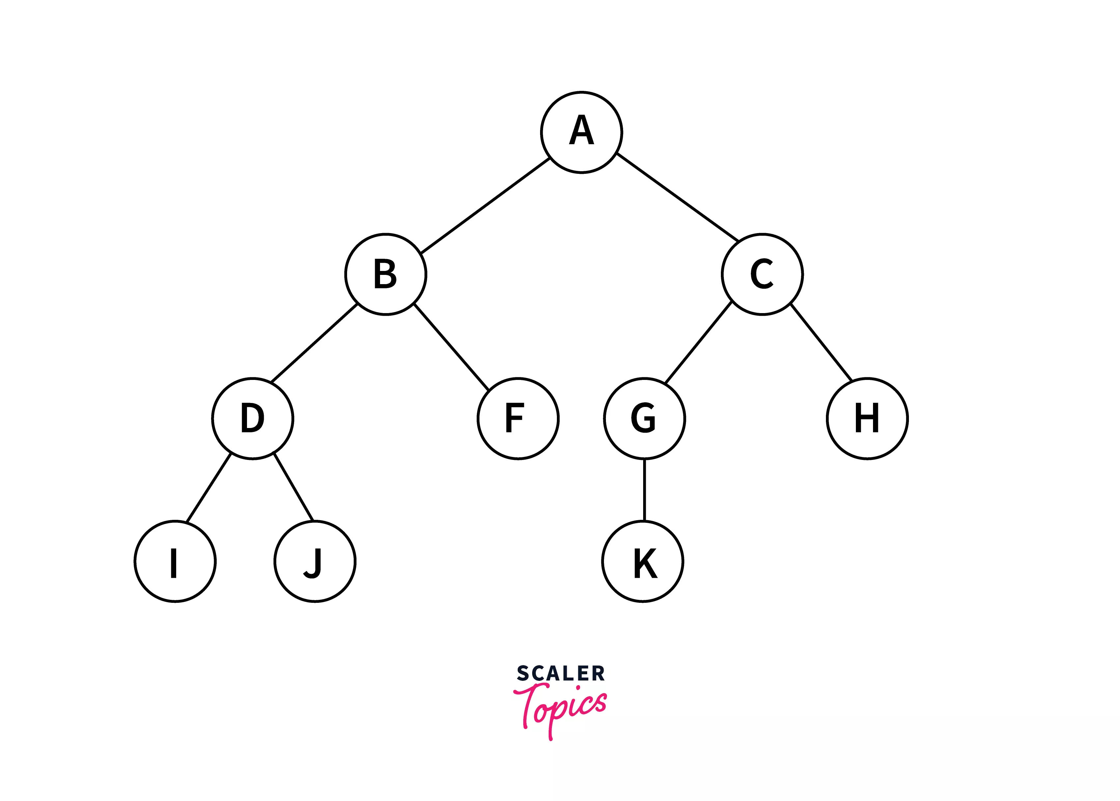
6. Representation of Binary Tree in C
A binary tree can be represented using a linked list and also using an array.
Representation of this tree, using both(array and linked list) is explained below.

Slide 31
6.1. Arraay Representation of Binary Tree
The binary tree can be represented using an array of size 2n+1, where n is the number of node.
If the parent element is at the index i, then
the left child will be stored at an index (2i)+1,
the right child will be stored at an index (2i)+ 2.
The parent of node i can be found at
position - (i – 1) / 2.

Slide 32
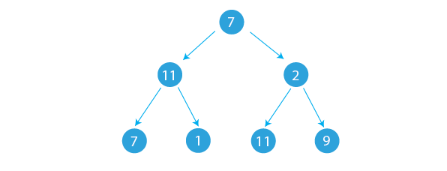
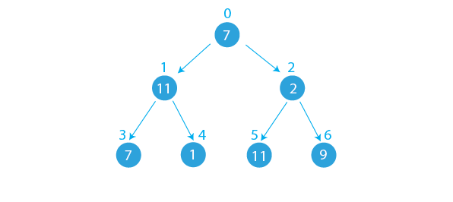

Consider The array representation of the binary tree as shown in the Figure -1 and 2
Number of nodes - N =7
Size of Array is = 2*N +1 = 2*7+1 = 15.
The left child of node i can be found at position - 2i + 1.
The right child of node i can be found at position - 2i + 2.
It is also possible to determine the parent of a node at position i using the formula:
The parent of node i can be found at position - (i – 1) / 2.
From Figure -3, It is observed that out of 15 memory locations, the 8 memory locations are unused and have been wasted
Figure -1
Figure -2
Figure -3

Slide 33
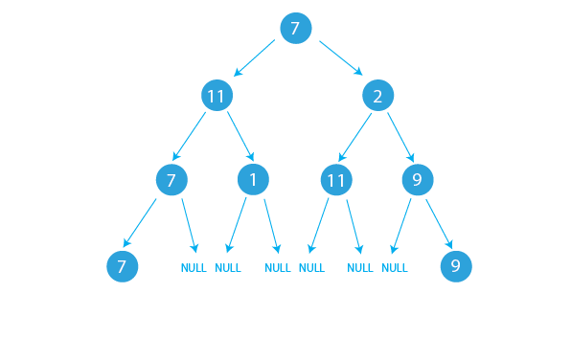
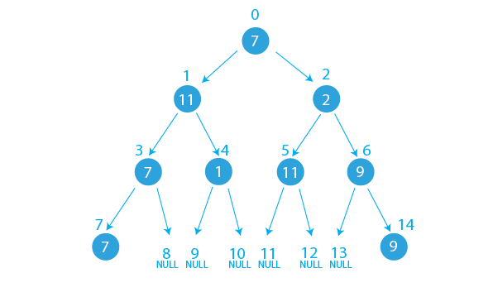
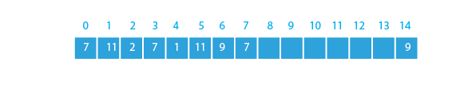
Consider the Figure -1 and Figure-2.
Number of nodes- N is 9
Array size 9*2+1 = 19
From Figure -2, it is observed that memory locations 8,9,10,11,12, 13, and 15 to 19 are unused and have been wasted
Figure -1
Figure -2
Figure -3

Slide 34
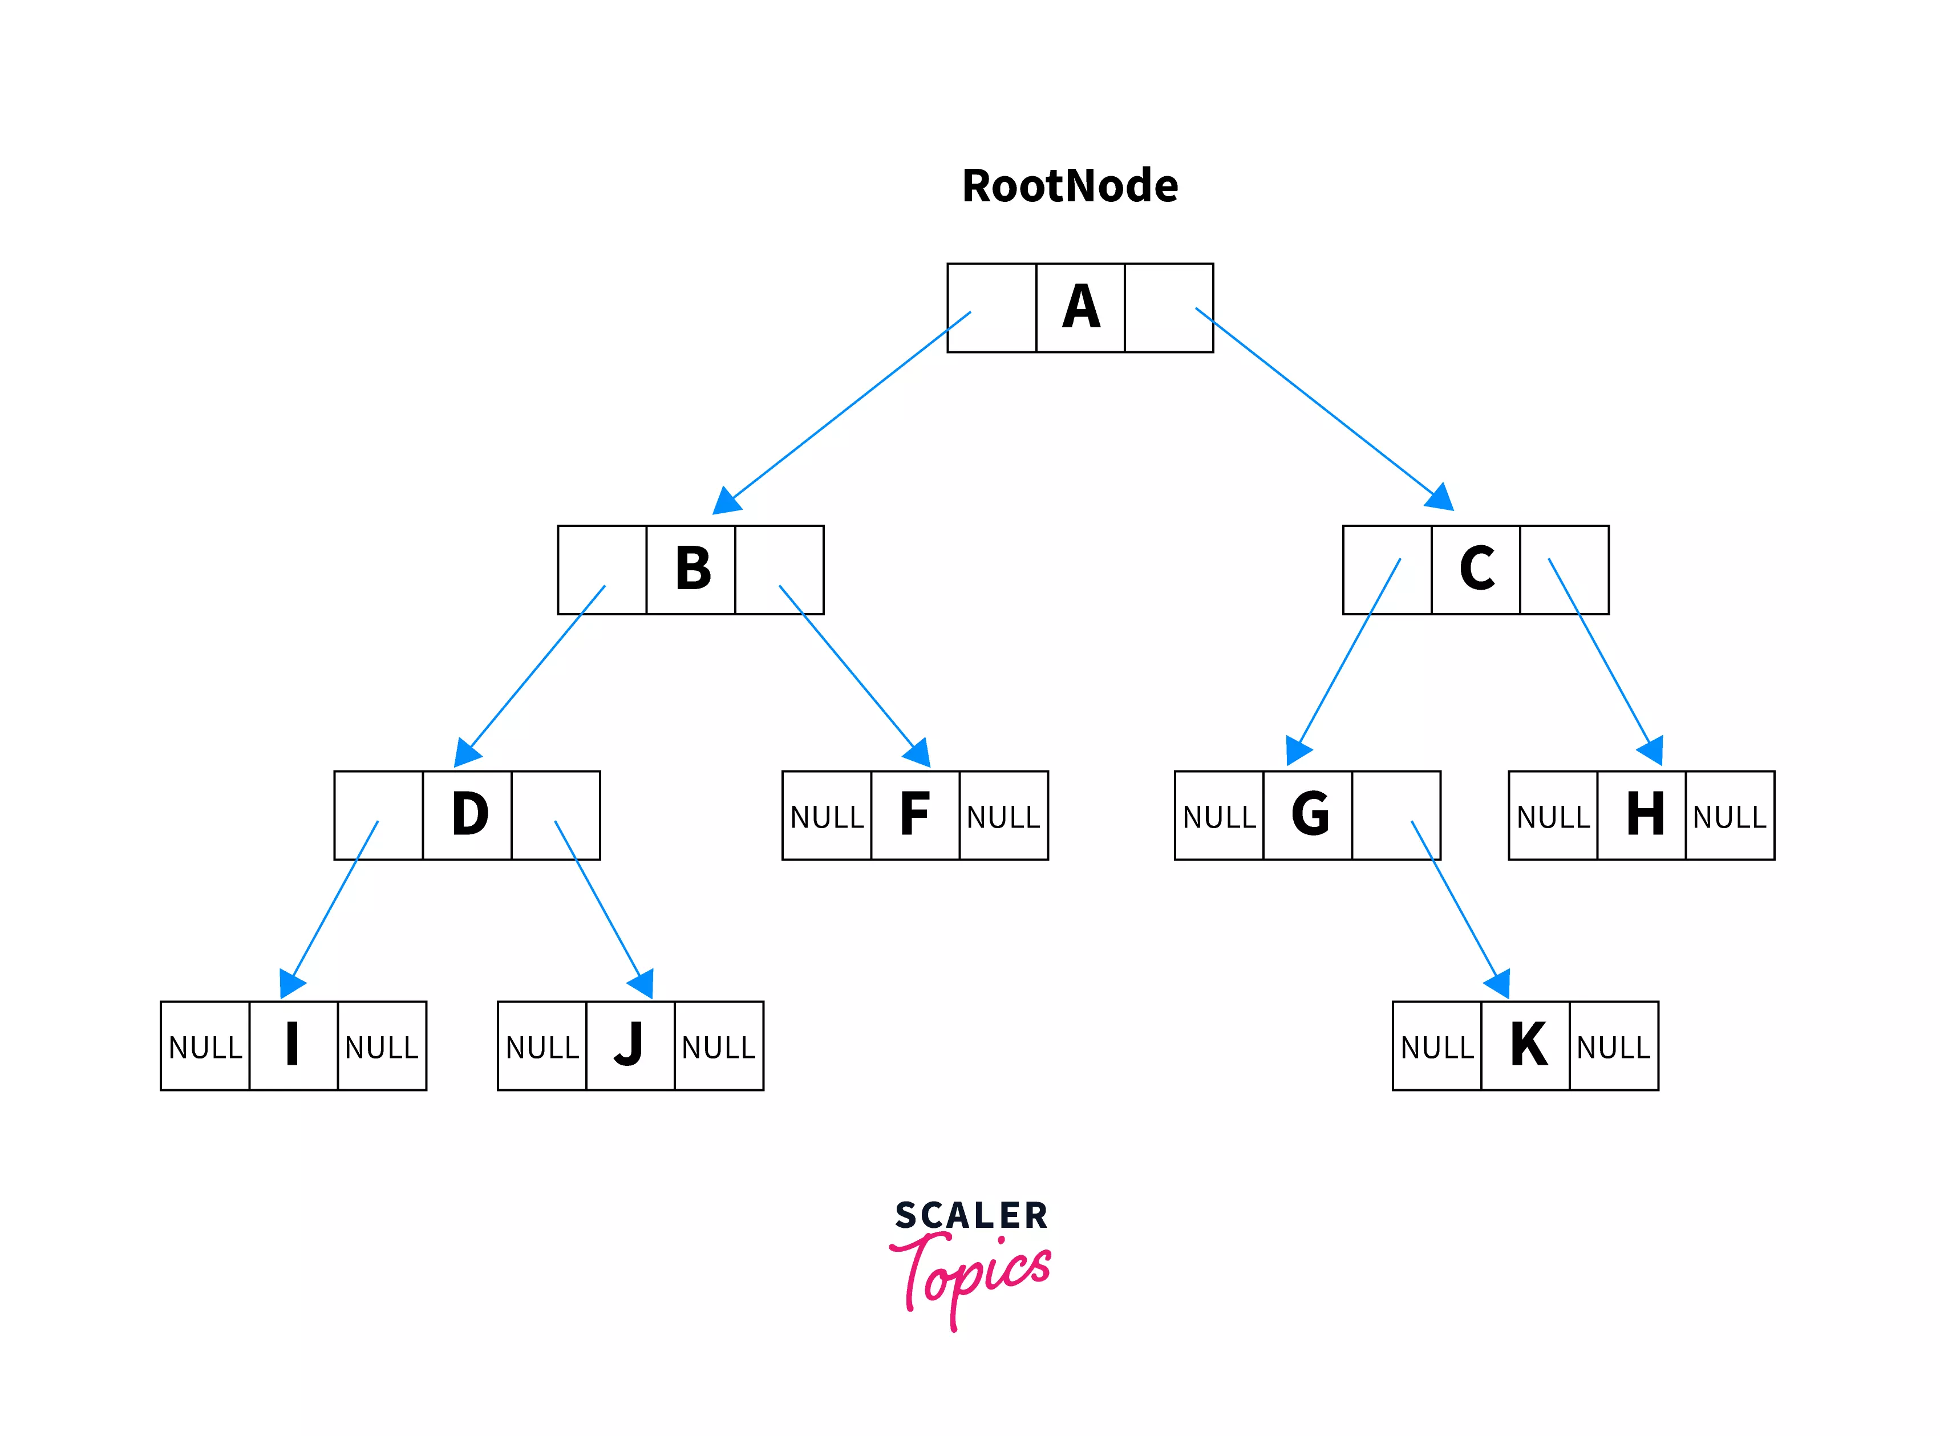
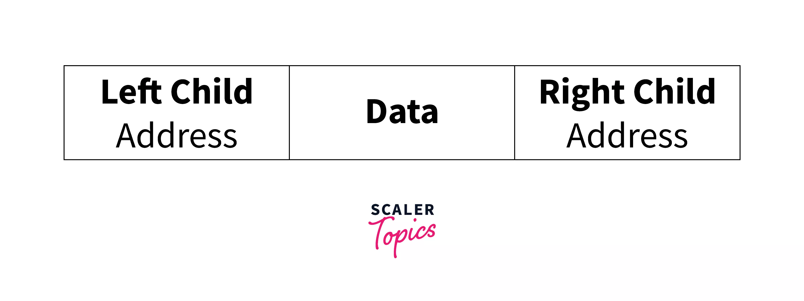
6.2. Linked List Representation :
For the linked list representation, we will use the doubly linked list, which has two pointers so that we can point to the left and right children of a binary tree node.
NULL is given to the pointer as the address when no child is connected.
The Linked list representation of the above binary tree is →

Slide 35
7.Basic operations on Binary Search Tree
Insertion: Adding a new node to a Binary Search Tree involves adjusting the pointers of the existing nodes either towards the left subtree or towards right subtree to maintain the proper sequence.
Deletion: Removing a node from a Binary Search Tree requires adjusting the pointers left and right side of the Binary Search Tree
Searching: Searching for a specific value in a Binary Search Tree involves traversing the Binary Search Tree from the root node until the value is found or the end of the Binary Search Tree.
Traversing : This involves the preorder, Inorder and Postorder techniques

Slide 36
9. Binary Search Tree implemetation using Linked List

Slide 37
Node Structure in a Binary Search Tree:
A node in a Binary Search Tree typically consists of three components :
1. Data: It holds the actual value or data
associated with the node.
2. Left Pointer: It stores the memory address
(reference) of the Left node..
3. Right Pointer: It stores the memory address
(reference) of the Right node..
4. Root : The Binary Tree is is accessed through the Root node, which points to the first node in the Binary Search Tree

Slide 38
C- implementation of NODE in a linked list
Since NODE in a BINARY SEARCH TREE is a collection of heterogenous data items (items with different data types), we can have the following structure defination for a NODE.
struct NODE {
int data;
struct NODE* left;
struct NODE* right;
}
we can have following pointer declation declaration to hold the address/reference of Node in a Binary Search Tree
struct NODE* root // root is pointer holding address of a First node in a Binary Tree

Slide 39
Algorithm for Insertion operation in Binary Search Tree
Step -1. START
Step -2. Create a new node with pointer - p
Step -3. Set p->data = x
Step -4. p->left =NULL
Step -5. p->right=NULL
Step -6. If (root = NULL)
Set root =p goto step 7
else if Begin

Slide 40
else begin
Set temp=root
while(temp != NULL)
Begin
Set r=temp
if(x < temp->data)
set temp = temp->left
else if(x > temp->data)
set temp = temp->right
end

Slide 41
if(x < r->data)
Set r->left=p
else
Set r->right=p
end
Step -7 End

Slide 42
Algorithm for Preorder Traversal in Binary Search Tree
Step -1. START
Step -2. Set temp =root
Step -3. if ( temp != NULL )
begin
print “ temp->data “
Call preorder(temp->left)
Call preorder(temp->right)
end
Step -4. End

Slide 43
Algorithm for Inorder Traversal in Binary Search Tree
Step -1. START
Step -2. Set temp =root
Step -3. if ( temp != NULL )
begin
Call Inorder(temp->left)
print “ temp->data “
Call Inorder(temp->right)
end
Step -4. End

Slide 44
Algorithm for Postorder Traversal in Binary Search Tree
Step -1. START
Step -2. Set temp =root
Step -3. if ( temp != NULL )
begin
Call Postorder(temp->left)
Call Postorder(temp->right)
print “ temp->data “
end
Step -4. End

Slide 45
Algorithm for Breadth First Search Traversal in Binary Search Tree
Step -1. Start
Step -2. Take an Empty Queue.
Step -3. Start from the root, and insert the root into the Queue.
Step -4. while (Queue is not empty)
Begin
Extract the node from the Queue and insert all its children into the Queue.
Print the data item from the extracted node.
End
Step -5. End

Slide 46
Iterative Breadth First Search Traversal Binary Search tree
void levelOrderTraversal(struct node* root) {
struct node* queue[1000]; // Create a queue for level-order traversal
int front = -1, rear = -1;
if (root == NULL) {
printf("The tree is empty.\n");
return;
}
queue[++rear] = root; // Enqueue the root node

Slide 47
while (front != rear) {
struct node* current = queue[++front]; // Dequeue a node and print its value
printf("%d ", current->data);
if (current->left != NULL) { // Enqueue the left child if exists
queue[++rear] = current->left;
}
if (current->right != NULL) { // Enqueue the right child if exists
queue[++rear] = current->right;
}
} // while end
printf("\n");
}

Slide 48
Working Example : Construct a binary Search tree for the following list of data items
list = {7, 16, 49, 82, 5, 31, 6, 2, 44, 56,102}
Show the Preorder, Inorder and Postorder traversal data items for the above constructed Binary Search Tree

Slide 49
Algorithm for Searching a Node in Binary Search Tree
Step -1. START
Step -2. Read “Key” to be serached
Step -3. Set temp =root
Step -4. while ( temp != NULL )
begin
if (key = temp->data)
Print “ Key is found in BST” goto 6
else if(key < temp->data)
Set temp=temp->left
else
Set temp=temp->right

Slide 50
End.
Step 5. print “ Key is not found in BST”
Step 6. End

Slide 51
Recursive Implementation of Binary Search Tree
Function prototype Design :
struct node* create_Node(int x);
struct node* Insertion_Node(struct node* root, int x);
struct node* search_Node(struct node* root, int key)
void postorder(struct node* temp);
void inorder(struct node* temp);
void preorder(struct node* temp);

Slide 52
struct node* create_Node(int x)
{
struct node* p;
p = (struct node* ) malloc(sizeof(struct node));
p->data = x;
p->left =NULL;
p->right=NULL;
return p;
}

Slide 53
struct node* Insertion_Node(struct node* root, int x)
{
if(root==NULL)
return create_Node(x);
if(x<root->data)
root->left = Insertion_Node(root->left, x);
else if(x>root->data)
root->right = Insertion_Node(root->right, x);
else
printf(“Duplicate data”)
return root;
}

Slide 54
struct node* search_Node(struct node* root, int key)
{
while(root != NULL) {
if(key == root->data){
return root;
} else if(key < root->data){
root=root->left;
} else{
root=root->right;
}
}
return NULL;
}

Slide 55
Deletion Operation : Delete function is used to delete the specified node from a binary search tree. However, we must delete a node from a binary search tree in such a way, that the property of binary search tree doesn't violate.
There are three situations of deleting a node from binary search tree.
1. The node to be deleted is a leaf node
2. The node to be deleted has only one child.
3. The node to be deleted has two children.

Slide 56
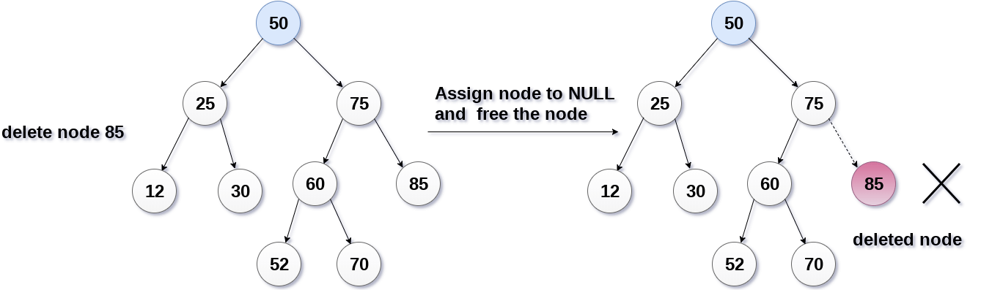
1. The node to be deleted is a leaf node : It is the simplest case, in this case, replace the leaf node with the NULL and simply free the allocated space.
In the following image, we are deleting the node 85, since the node is a leaf node, therefore the node will be replaced with NULL and allocated space will be freed.

Slide 57
2. The node to be deleted has only one child : In this case, replace the node with its child and delete the child node, which now contains the value which is to be deleted. Simply replace it with the NULL and free the allocated space.
In the following image, the node 12 is to be deleted. It has only one child. The node will be replaced with its child node and the replaced node 12 (which is now leaf node) will simply be deleted.

Slide 58
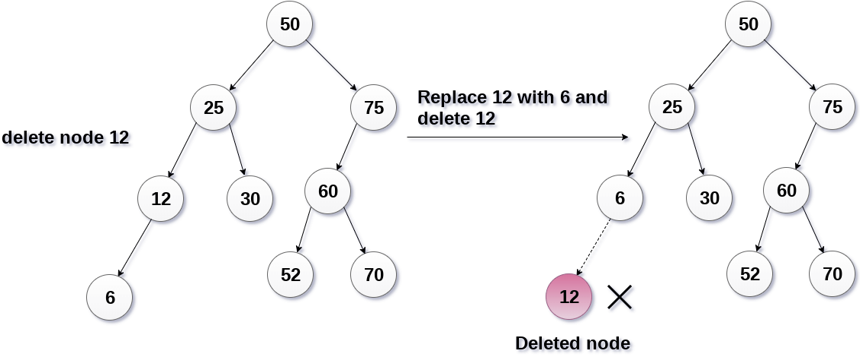

Slide 59
3.The node to be deleted has two children. :
It is a bit complexed case compare to other two cases.
However, the node which is to be deleted, is replaced with its in-order successor or predecessor recursively until the node value (to be deleted) is placed on the leaf of the tree.
After the procedure, replace the node with NULL and free the allocated space.

Slide 60
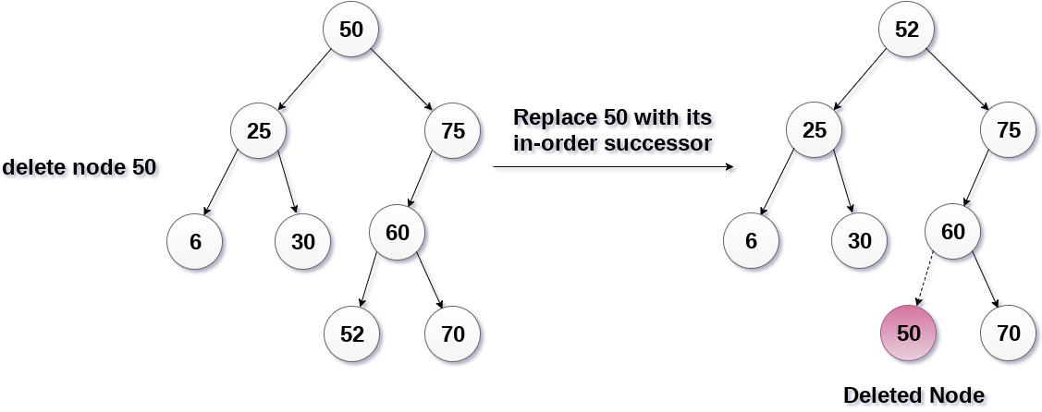
In the following image, the node 50 is to be deleted which is the root node of the tree. The in-order traversal of the tree given below.
6, 25, 30, 50, 52, 60, 70, 75.
replace 50 with its in-order successor 52. Now, 50 will be moved to the leaf of the tree, which will simply be deleted.

Slide 61
HEAP Data Structure

Slide 62
1. What is Heap Data Structure?
2. Examples of Heap Data Structure?
3. Types of Heap data structure.
4. Operations on Heap Data Structure
5. Implementation Heap Data Structure
6. Applications of Heap Data structure

Slide 63
1. What is Heap Data Structure?
A heap is a complete binary tree, in which all the levels except the last level, i.e., leaf node should be completely filled (filled means- all leaf nodes are at same level), and all the nodes should be left-justified.
Every parent node satifies the heap property which says that the value of Parent node is either greater than or equal to (in a max heap ) or less than or equal to (in a min heap) the value of the Child node.

Slide 64
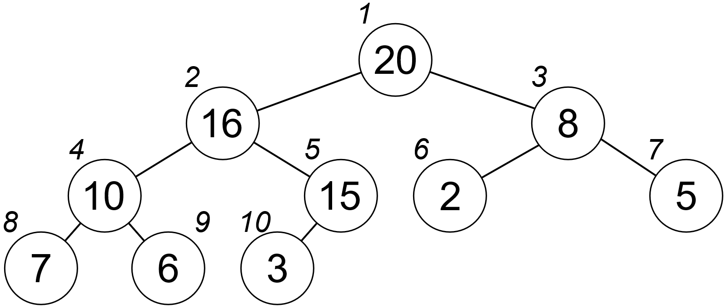
2. Examples of Heap and Complete Binary Tree
Not aComplete Binary Tree
Complete Binary Tree
1
A
A
2
B
B
3
C
C
D
E
4
5
6
7
F
G
D
E
F
G
8
9
H
I
J
K
H
I
Complete Binary Tree with Heap property

Slide 65
Illustration of the heap’s definition
a heap
not a heap
not a heap
Note: Heap’s elements are ordered top down (along any path down from its root), but they are not ordered left to right

Slide 66
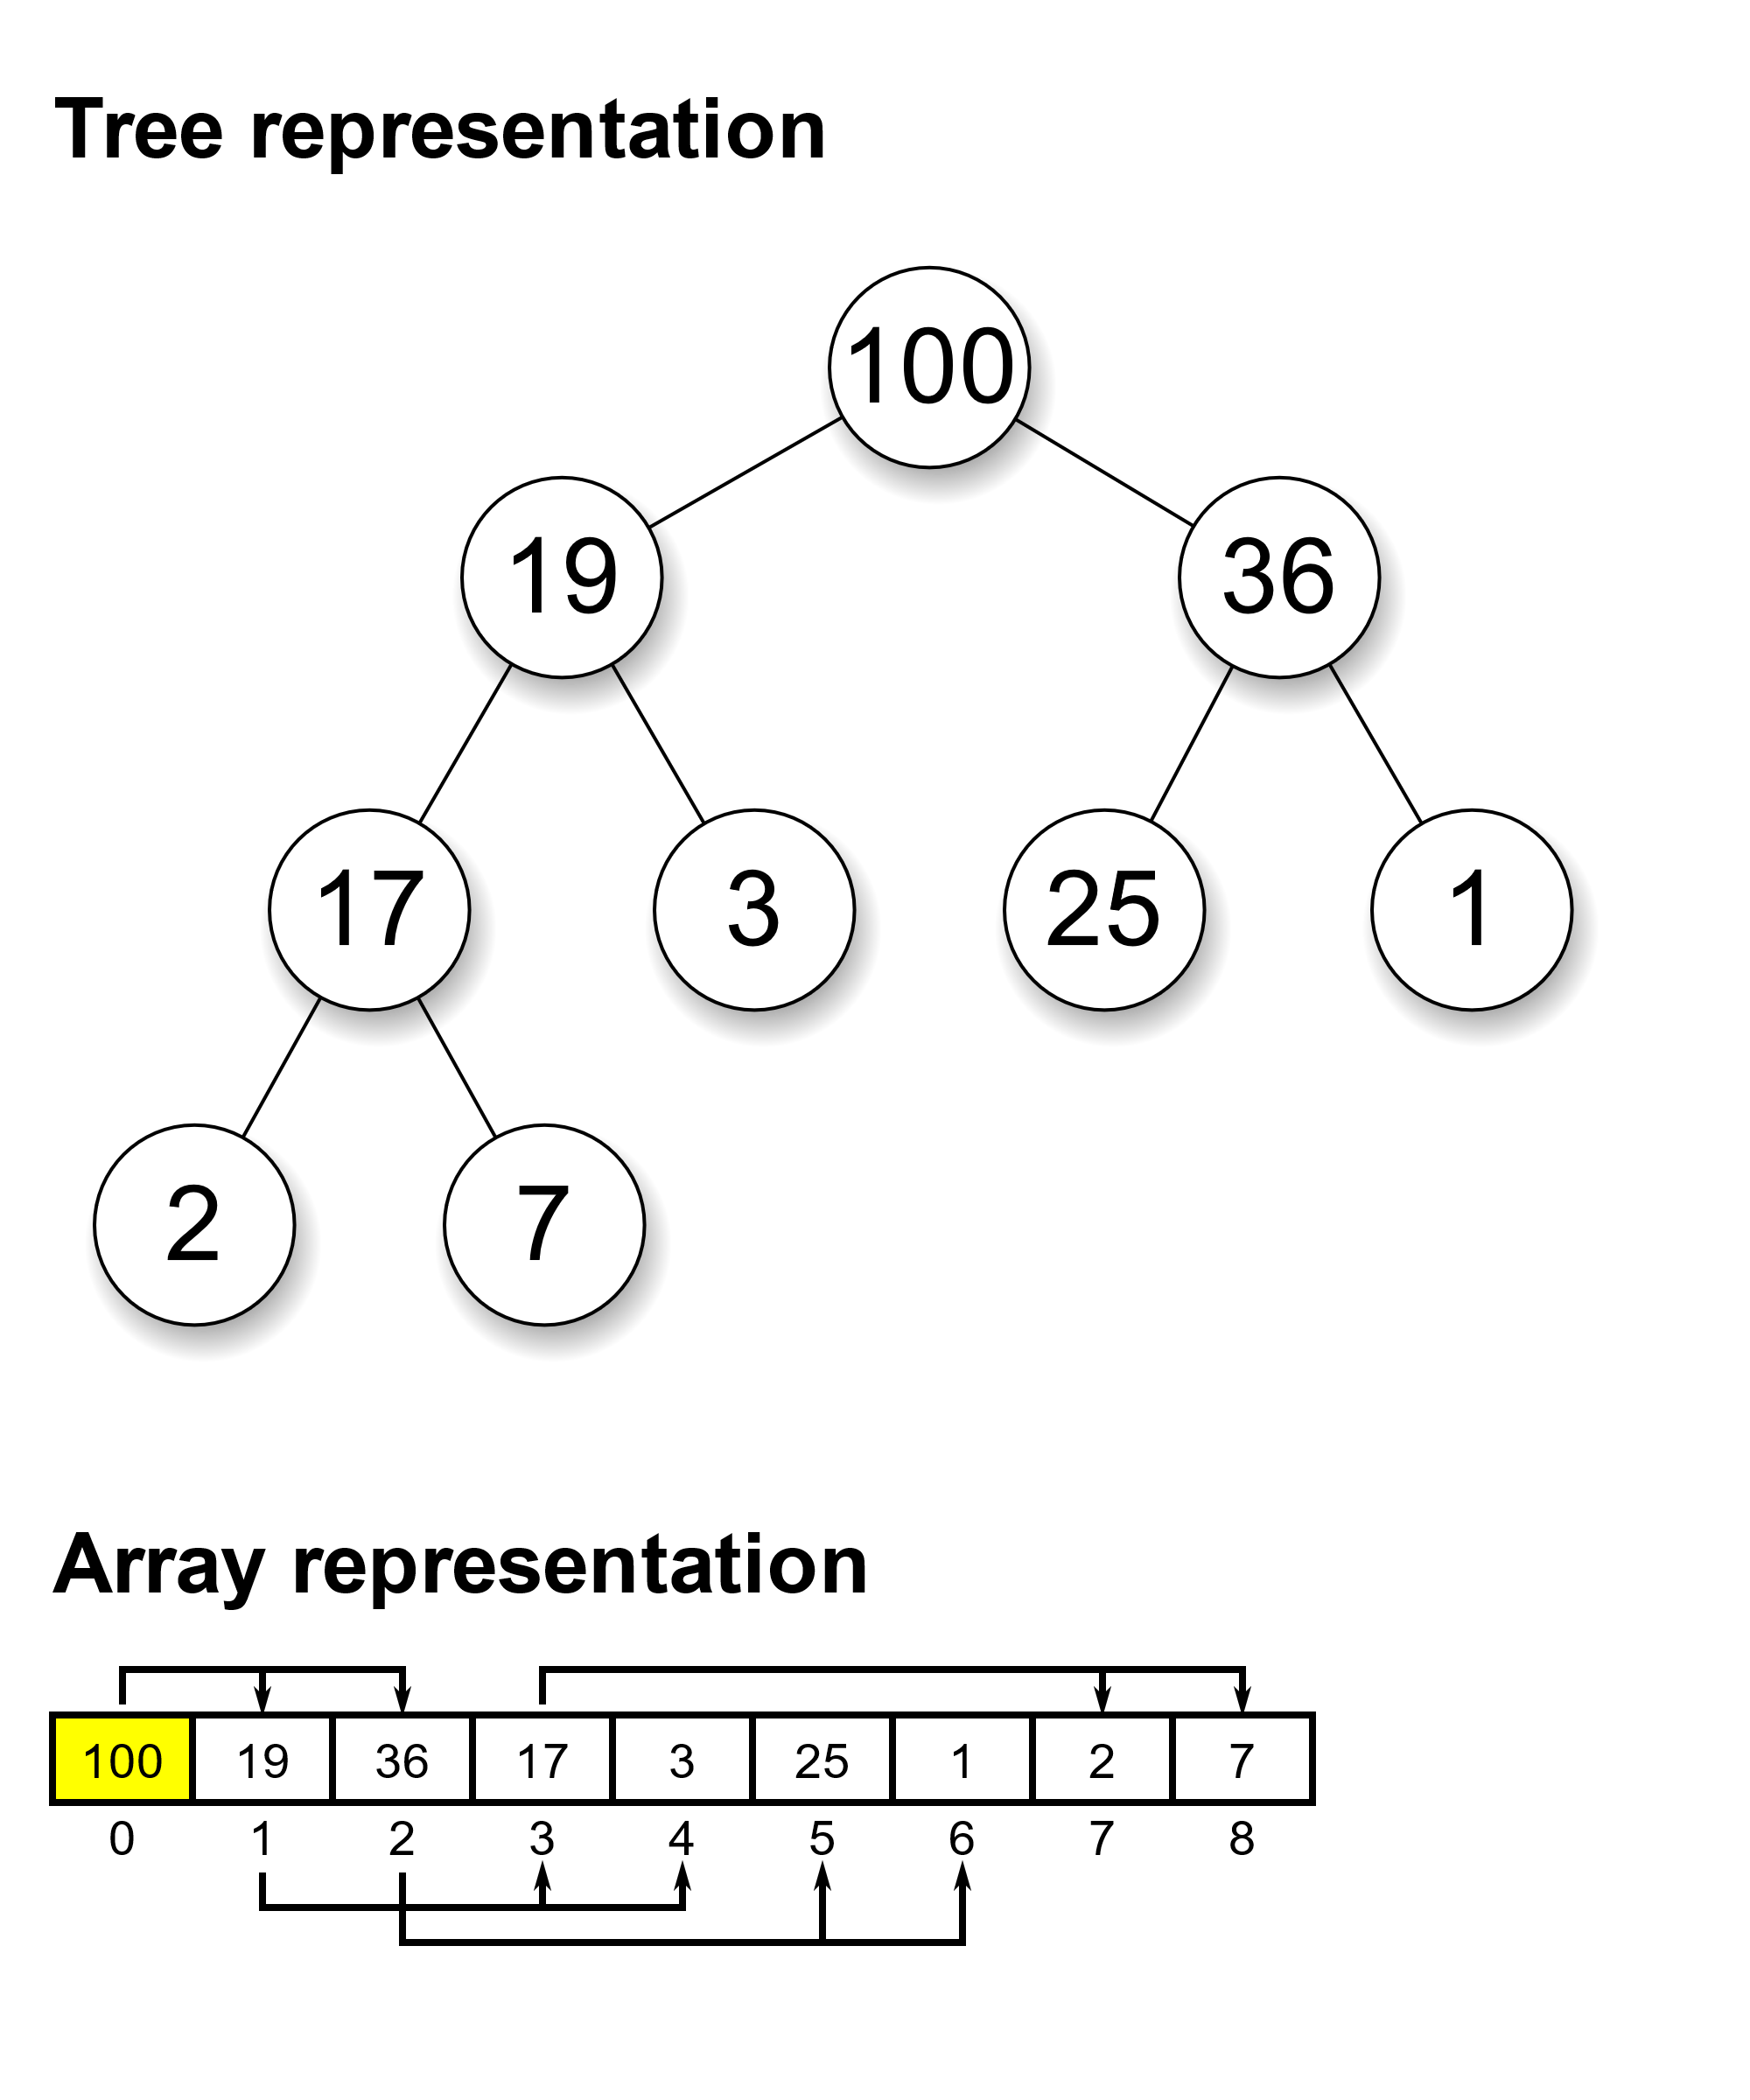
3. Types of Heap data structure.
1. Max Heap : In a max heap, the key present at the root is the largest in the heap and all the values below this are less than this value.

Slide 67
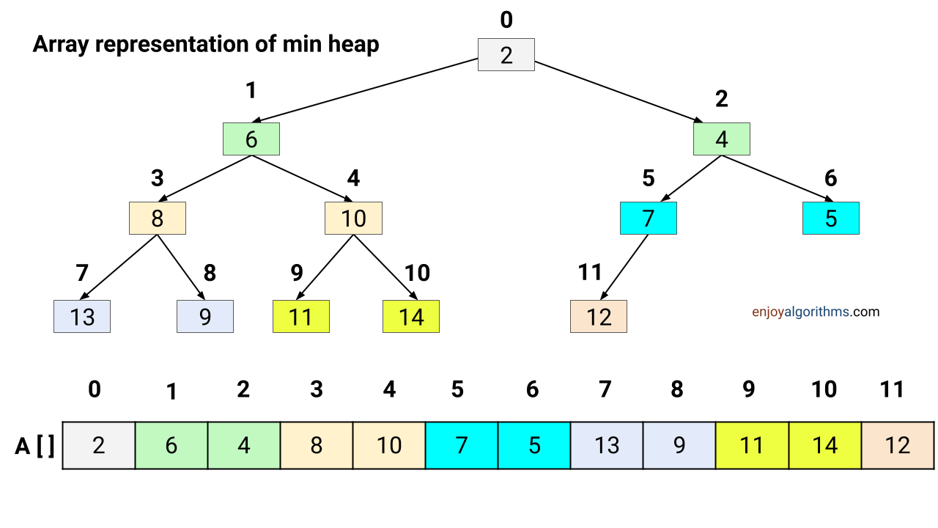
2. Min Heap : In a min heap, the key present at the root is the smallest in the heap and all the values below this are greater than this value.

Slide 68
4. Operations on Heap Data Structure
Heap Operations : The following operations can be performed on a heap data structure:
1. Insertion : A new element is always inserted at the last child of the original heap. The new element may now violate the heap property that a heap must satisfy.
Therefore, an operation known as reheapify upward is performed on the heap. The aim of the reheapify operation is to compare the new value inserted with its parent’s value.
If the value is greater (in a max heap) or smaller (in a a min heap) it is swapped with its parent.
The process is then continued from the parent node recursively until the heap property is satisfied or the root node is hit.

Slide 69
Step 1 − Create a new node at the end of heap.
Step 2 − Assign new value to the node.
Step 3 − Compare the value of this child node with its parent.
Step 4 − If value of parent is less than child, then swap them.
Step 5 − Repeat step 3 & 4 until Heap property holds.

Slide 70
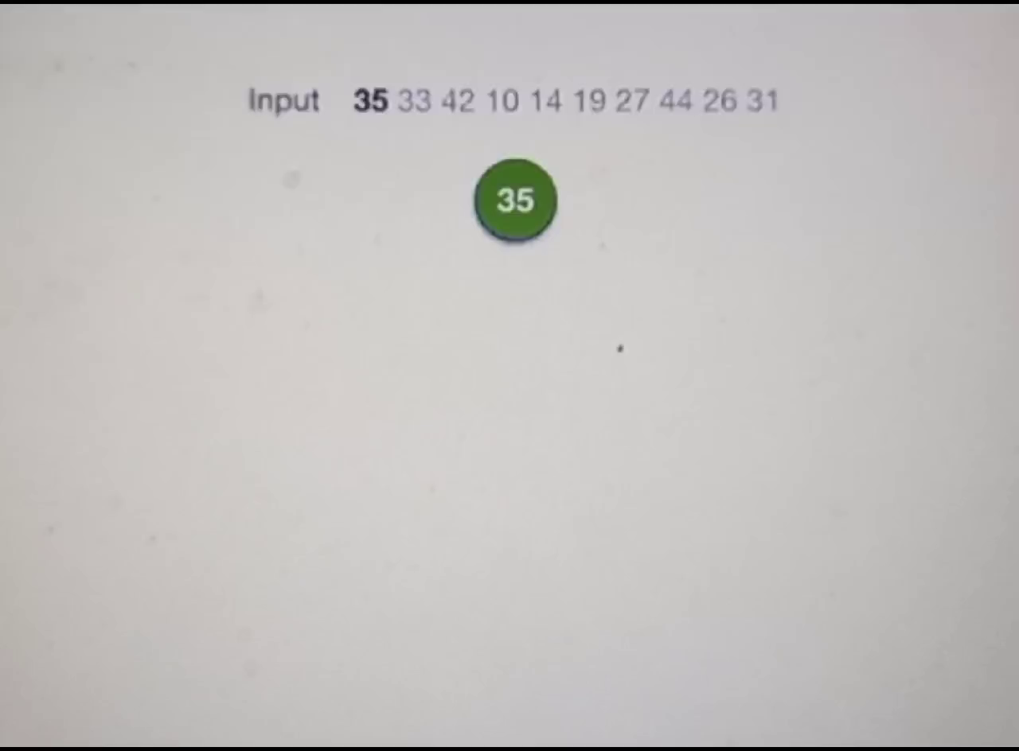

Slide 71
Deletion :
An element is always deleted from the root of the heap.
When deleting an element will leave a hole in the heap, which
disturbs the requirement that the heap must be a complete
binary tree.
To fill this hole, the last node in the heap is swapped to this place. where root was placed. This causes the heap to violate the heap property.
Similar to inserting an element, an operation known as reheapify downward is performed on the heap.
The value of the root node is first replaced with the largest (or smallest) value amongst its children.
Then the down heap property is repeated from this child again recursively until we hit the leaf node.

Slide 72
Step 1 − Remove root node.
Step 2 − Move the last element of last level to root.
Step 3 − Compare the value of this child node with its parent.
Step 4 − If value of parent is less than child, then swap them.
Step 5 − Repeat step 3 & 4 until Heap property holds.

Slide 73
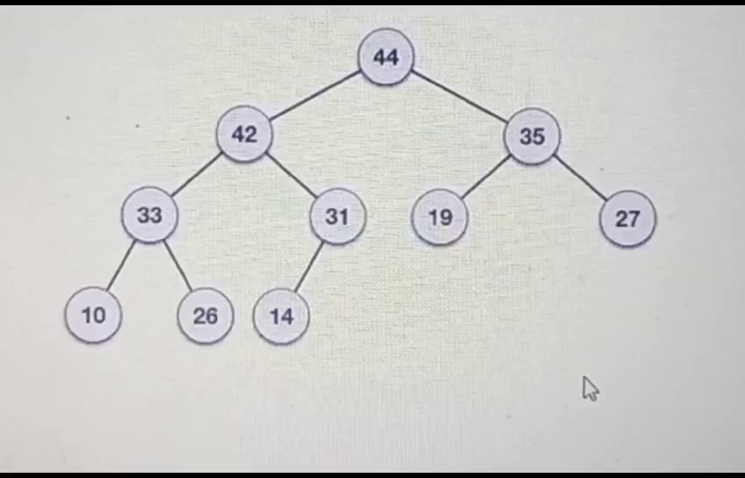

Slide 74
Heap’s Array Representation and Implementation
Illustration of Storing heap’s elements into an array (whose elements indexed, for convenience, 1 to n) in top to bottom, left-to-right order level wise
Example:
Important points for implementation:
Left child of node j is at 2j
Right child of node j is at 2j+1
Parent of node j is at (j/2)
Parental (ie interior) nodes are in the first (n/2) locations of an array
leaf nodes are present at locations from (n/2) +1 to n of an array
i.e.The elements in the subarray A[((n/2) +1) .. n] are leaves
9
1 2 3 4 5 6
5
3
9 5 3 1 4 2
1
4
2

Slide 75
Stage-1 Building Max-Heap (bottom-up)
Step 1: Starting with the last (rightmost) parental (ie interior) node, fix the heap rooted at it, if it doesn’t satisfy the heap condition: keep exchanging it with its largest child until the heap condition holds.
Step 2: Repeat Step 1 for the preceding parental node
Note : Bottom up: Adding nodes to heap from bottom to top, pushing elements down, as needed in Step 1 is called Heapify

Slide 76
Example to Building a Heap with Bottom-Up Approach
Convert an array A[1 … n] into a max-heap (n = length[A]) by using bottom-up heap construction - n=10
Apply HEAPIFY on elements between 1 to (n/2) - 1 to 5
i.e 5-parent nodes they are 4,1,3,2,16
1
4
2
3
A:
4 | 1 | 3 | 2 | 16 | 9 | 10 | 14 | 8 | 7
1
3
4
5
6
7
2
16
9
10
8
9
10
14
8
7

Slide 77
Example: A
4 | 1 | 3 | 2 | 16 | 9 | 10 | 14 | 8 | 7
i = 5
i = 4
i = 3
1
1
1
4
4
4
2
3
2
3
2
3
1
3
1
3
1
3
4
5
6
7
4
5
6
7
4
5
6
7
2
16
9
10
2
16
9
10
14
16
9
10
8
9
10
8
9
10
8
9
10
14
8
7
14
8
7
2
8
7
i = 2
i = 1
1
1
1
4
4
16
2
3
2
3
2
3
1
10
16
10
14
10
4
5
6
7
4
5
6
7
4
5
6
7
14
16
9
3
14
7
9
3
8
7
9
3
8
9
10
8
9
10
8
9
10
2
8
7
2
8
1
2
4
1
16 | 14 | 10 | 8 | 7 | 9 | 3 | 2 | 4 | 1

Slide 78
Bottom Up Heap construction
Algorithm Creation_HeapBottomUp(H[1,n])
// Construct a heap from the elements of given array by
// the bottom up approach
// Input : An array H[1,n] of orderable items
// Output : A heap array H[1.n]
for i= n/2 downto 1 do
Begin
HeapAdjust(H, i, n) // Call heap adjust procedure to
End // build the heap staring with rightmost parent node
Initial call : Creation_HeapBottomUp(H[1, n])

Slide 79
Heap adjust algorithm :
Algorithm HeapAdjust(H, i, n)
// Construct a heap array by heap bottom up approach
// Input : An array H[1,n] of orderable items
// Output : A heap array H[1.n]
k←i; v ←H[k] // fixing the parent node for rooting the heap
heap ← false
while not heap and 2k ≤ n do
Begin
j ←2*k // left child of parent node being considered for heapify
if j < n // There are two children
if H[j] < H[j+1] j ← j+1 // searching for child with larger value
if v ≥ H[j] // parent node satisfies the heap property
heap ← true
else H[k] ← H[j]; k ← j // move child node at the location of parent’s node
H[k] ← v // move parent node to child’s position to
end // Satisfy the heap property

Slide 80
Algorithm for Insertion_Heap
Algorithm Insertion_Heap(H, n)
step -1 : Read Key
Step-2 : if (n<MAX-1)
begin
set n=n+1
set H[n]=key
call Creation_HeapBootomUp(H,n)
end
else print “ Heap full”
Step-3 : end

Slide 81
Algorithm for deletion_deletion
Algorithm deletion_deletion(H, n)
step -1 : Read Key
Step-2 : if (n!=0)
begin
print " H[1] as heap root node deleted "
set H[1]=H[n]
set n=n-1
call Creation_HeapBootomUp(H,n)
end
else print “ Heap Underflow”
Step-3 : end

Slide 82
Algorithm Display_Heap
Algorithm Display_Heap(H, n)
step -1 : for i =1 to n Do
begin
print " i-th element from the heap array H”
end
Step-3 : end

Slide 83
Function prototype Declarations
void HeapAdjust(int H[],int i,int n);
void Creation_HeapBootomUp(int H[],int n);
void Insertion_Heap(int H[],int n);
void Display_Heap(int H[], int n);
void Delete_Heap(int H[], int n);

Slide 84
Application of Heap Data structure :
Priority Queues: Heaps are commonly used to implement priority queues, where elements with higher priority are extracted first. This is useful in many applications such as scheduling tasks, handling interruptions, and processing events.
Sorting Algorithms: Heapsort, a comparison-based sorting algorithm, is implemented using the Heap data structure. It has a time complexity of O(n log n), making it efficient for large datasets.
Graph algorithms: Heaps are used in graph algorithms such as Dijkstra’s shortest path algorithm, Prim’s minimum spanning tree algorithm, and the A* search algorithm.
File Compression: Heaps are used in data compression algorithms such as Huffman coding, which uses a priority queue implemented as a min-heap to build a Huffman tree.
Dynamic programming: Heaps are used in dynamic programming algorithms such as the greedy algorithm, where elements are processed in order of priority.
Medical Applications: In medical applications, heaps are used to store and manage patient information based on priority, such as vital signs, treatments, and test results.
External sorting: Heaps are used in external sorting algorithms to sort large datasets that do not fit into memory, by processing chunks of data in a priority queue.
Load balancing: Heaps are used in load balancing algorithms to distribute tasks or requests to servers, by processing elements with the lowest load first.
Online algorithms: Heaps are used in online algorithms, where elements are processed in real-time as they arrive, such as recommendation systems, event processing, and streaming data.
Stock market: Heaps are used in financial applications, such as stock market analysis and algorithmic trading, to process and manage large amounts of stock data based on priority.

Slide 85
END of UNIT-IV

